Slide 1
Zagorske štrukle

Slide 2
Recipe
For dough:
For the mixture:
1 egg
4 tablespoons oil
1,5 decilitres of water
1 teaspoon salt
400 grams of smooth flour
500 grams of cow’s cheese
1 egg
A little oil
2 teaspoons salt
For the end:
A little oil
Sour cream

Slide 3
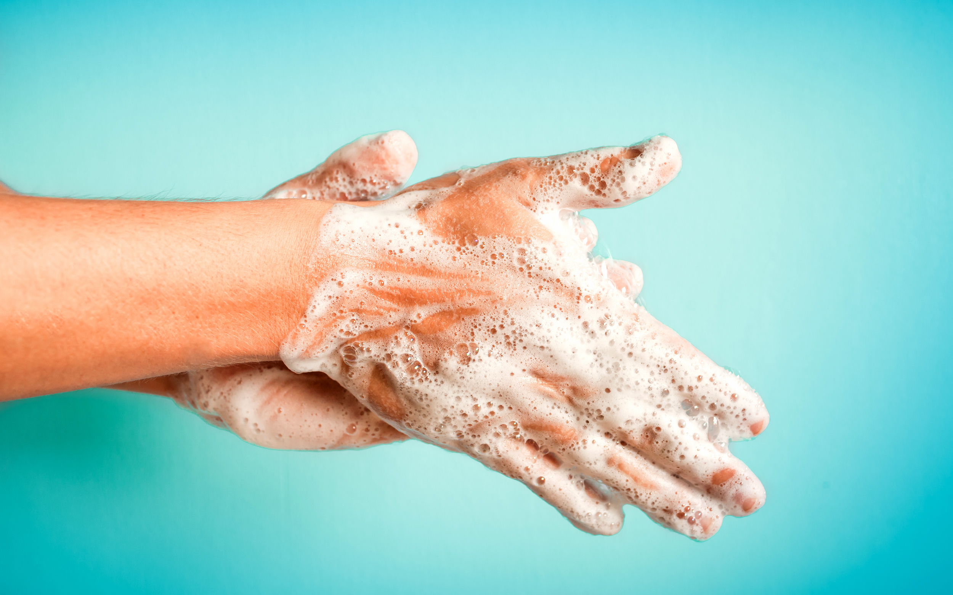
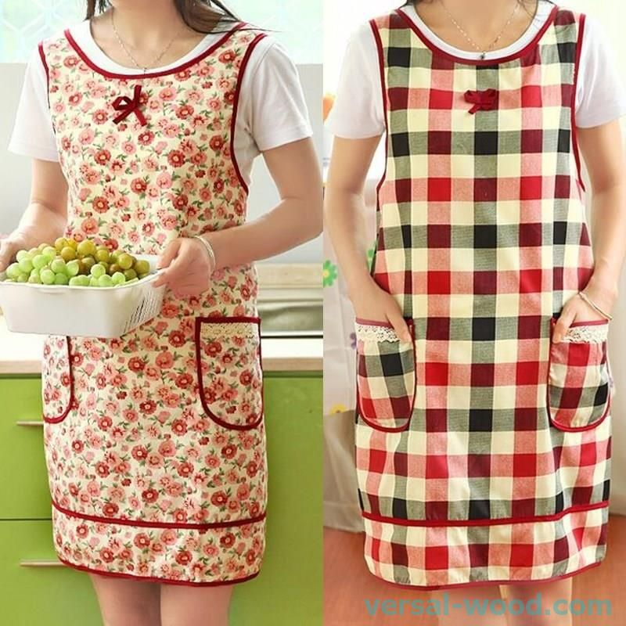
But first:
Wash your hands
Put on an apron
If you have long hair, tie it up
Prepare all the ingredients and you can start

Slide 4
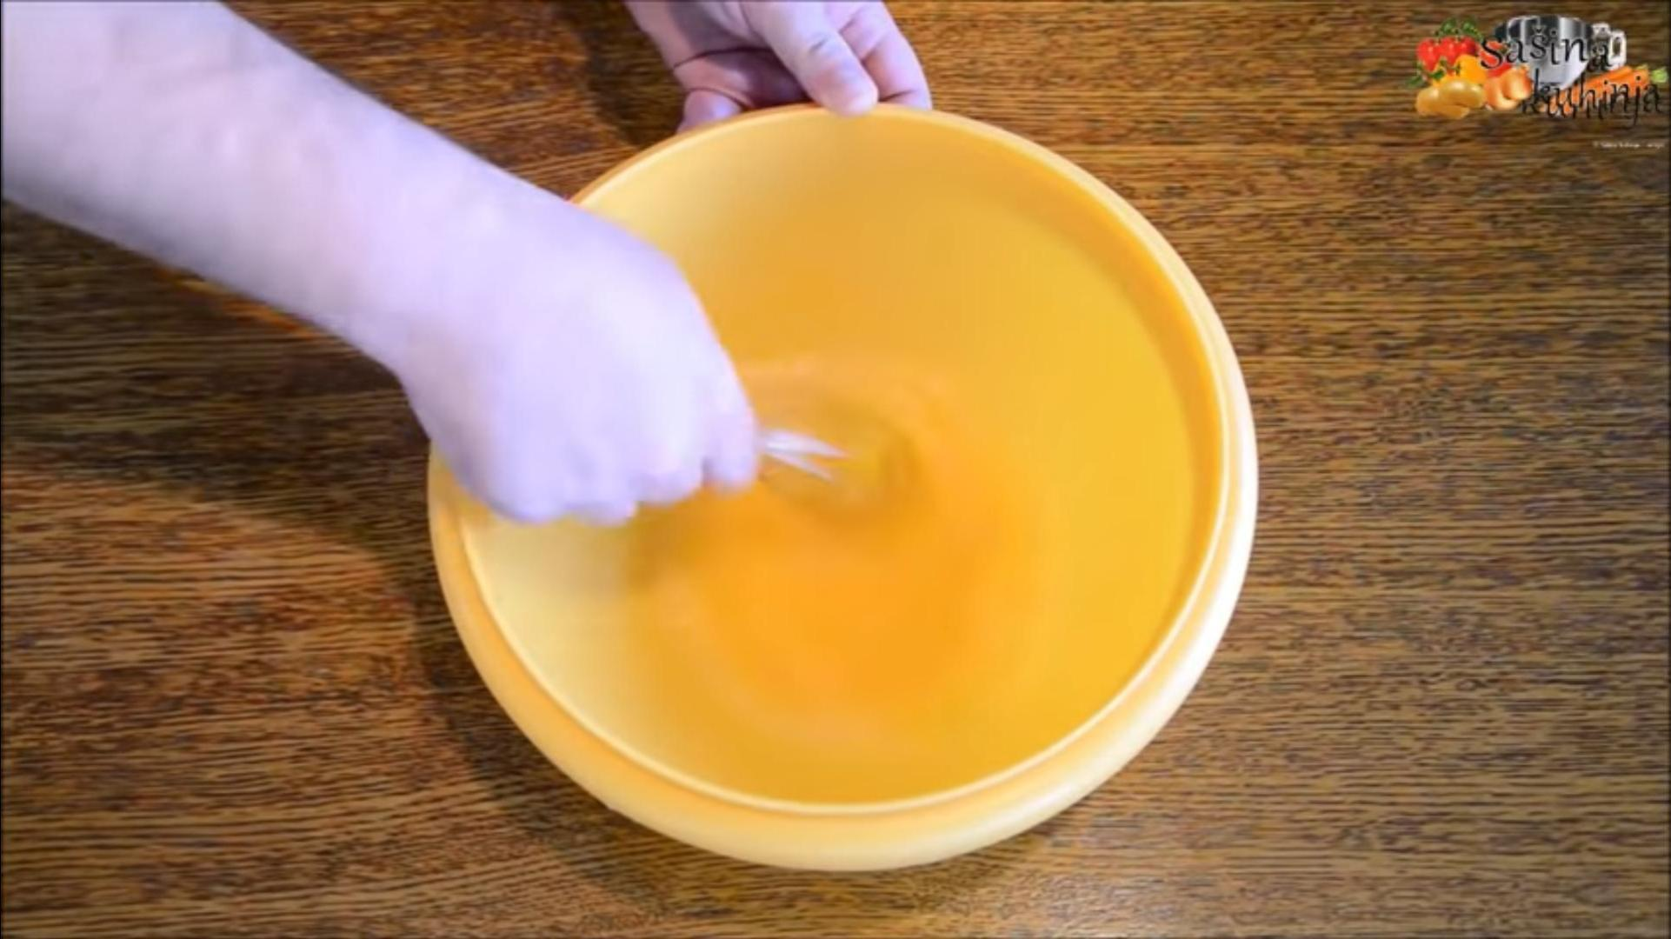
First step
Put in the bowl:
1 egg
4 tablespoons oil
1,5 decilitres of water
1 teaspoon salt
Then mix these ingredients with a whisk

Slide 5
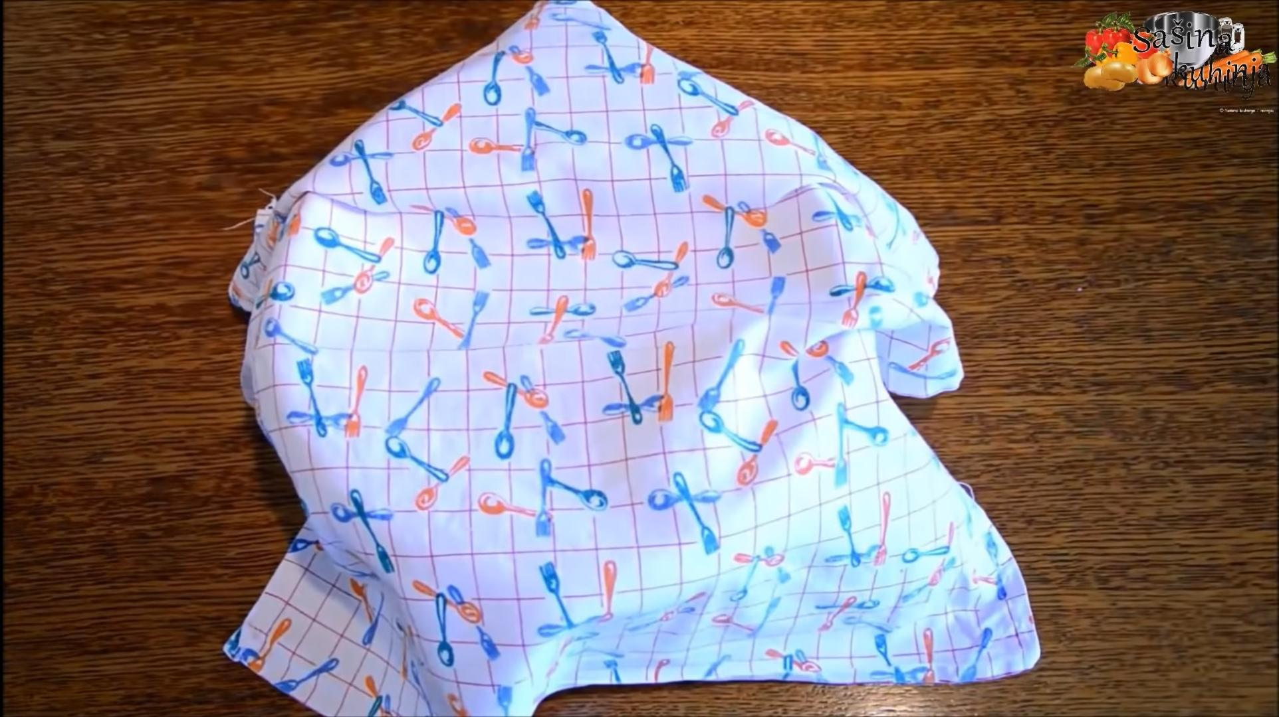
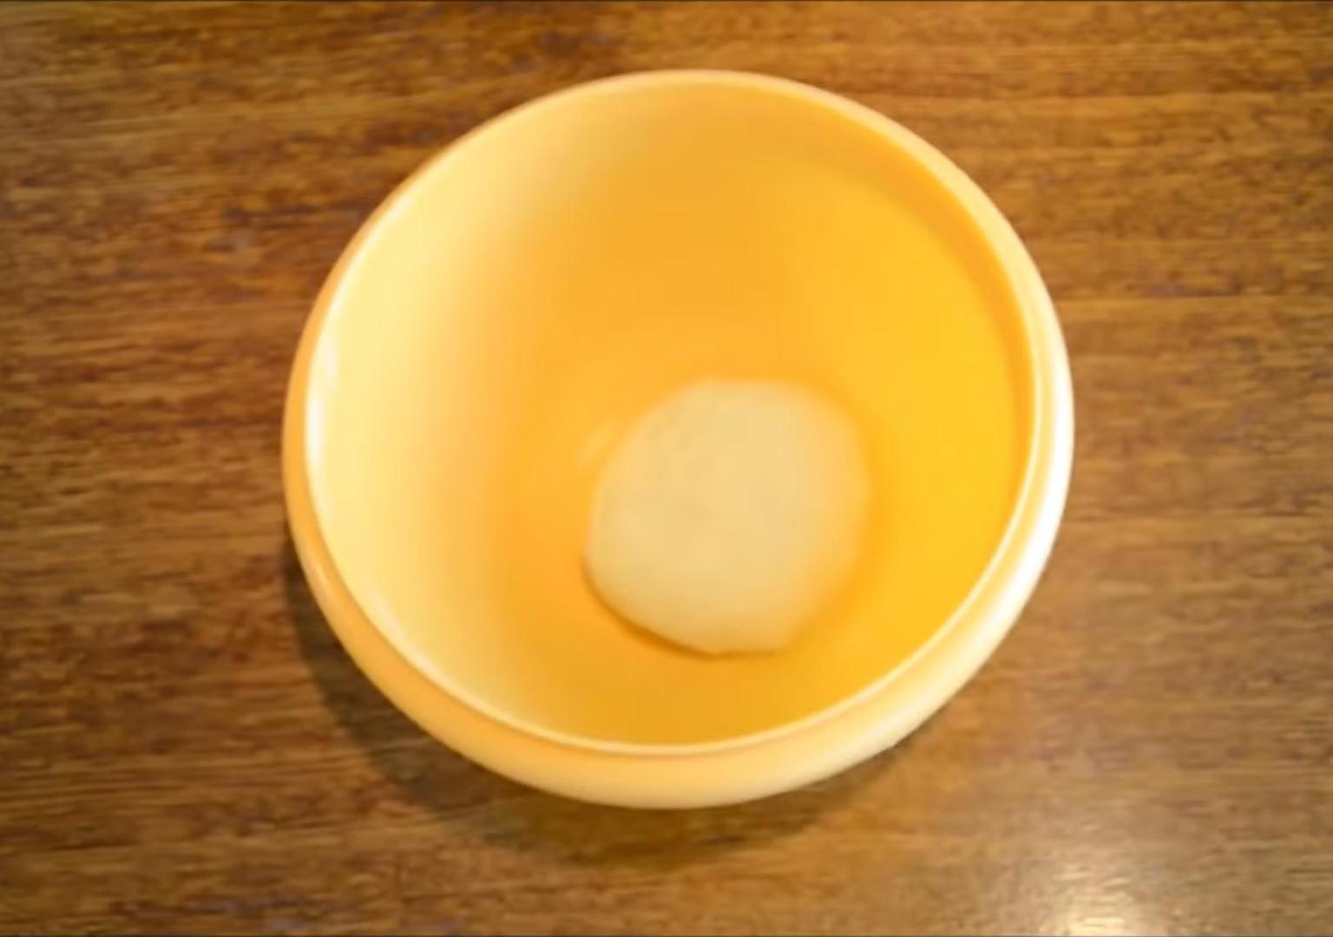
Second step
Add 400 grams of fluor in bowl and mix with your hands for a few minutes
Leave the dough covered for 10 minutes to rest

Slide 6
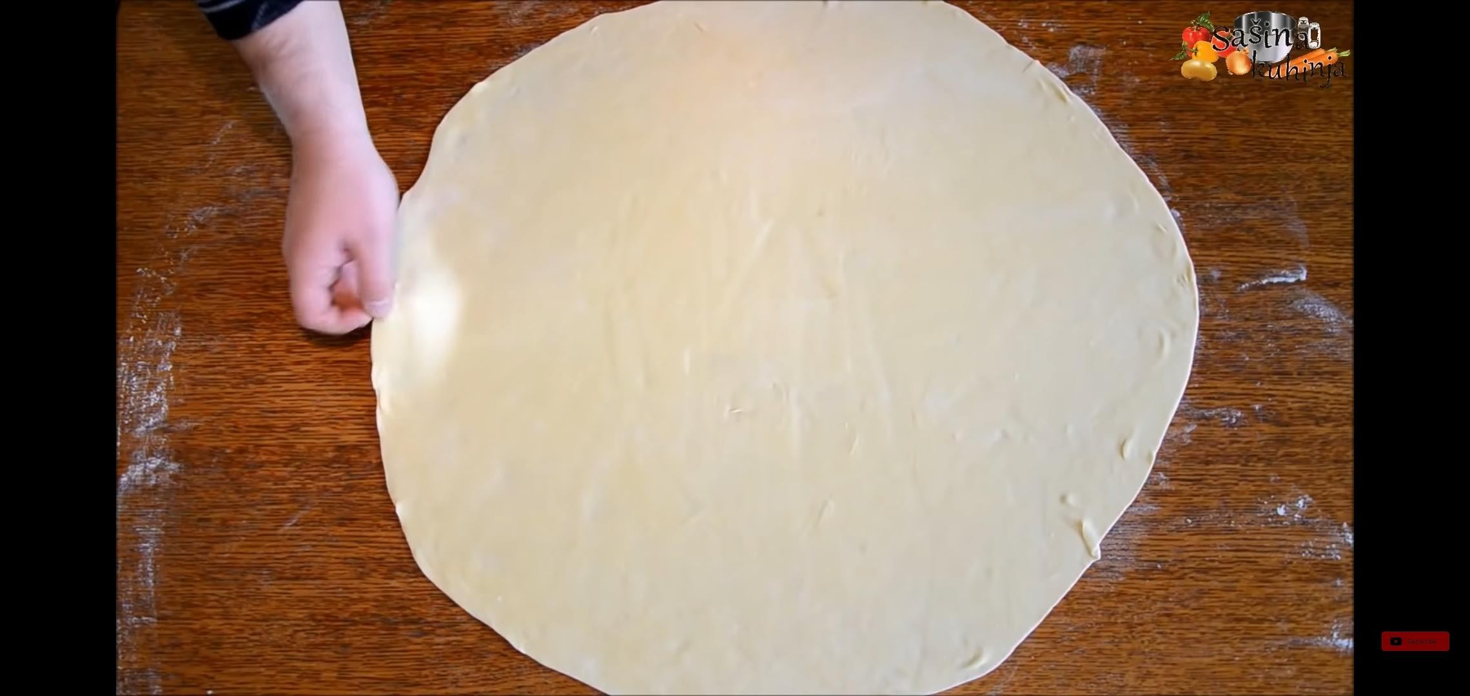
Third step
Roll out the round dough with a little flour to make it 2 millimeters thick

Slide 7
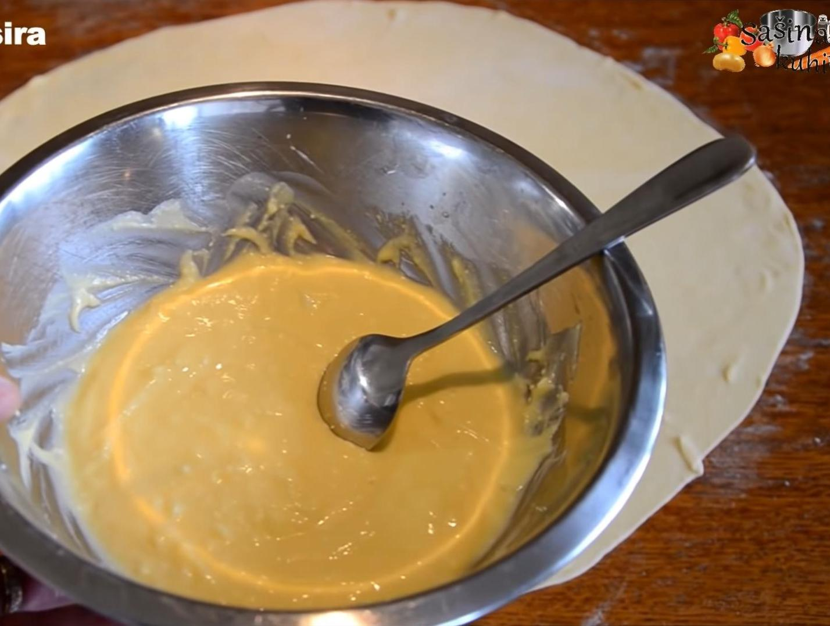
Fourth step
Mix in the bowl:
500 grams of cow’s cheese
1 egg
A little oil
2 teaspoons salt

Slide 8
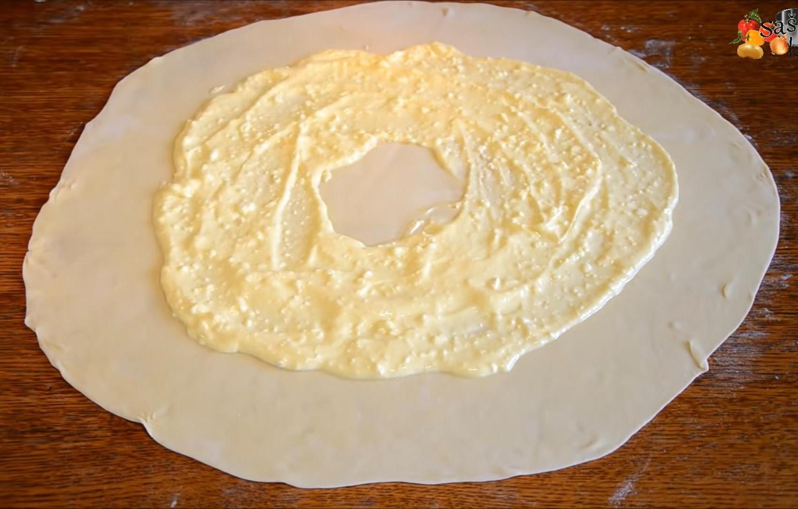
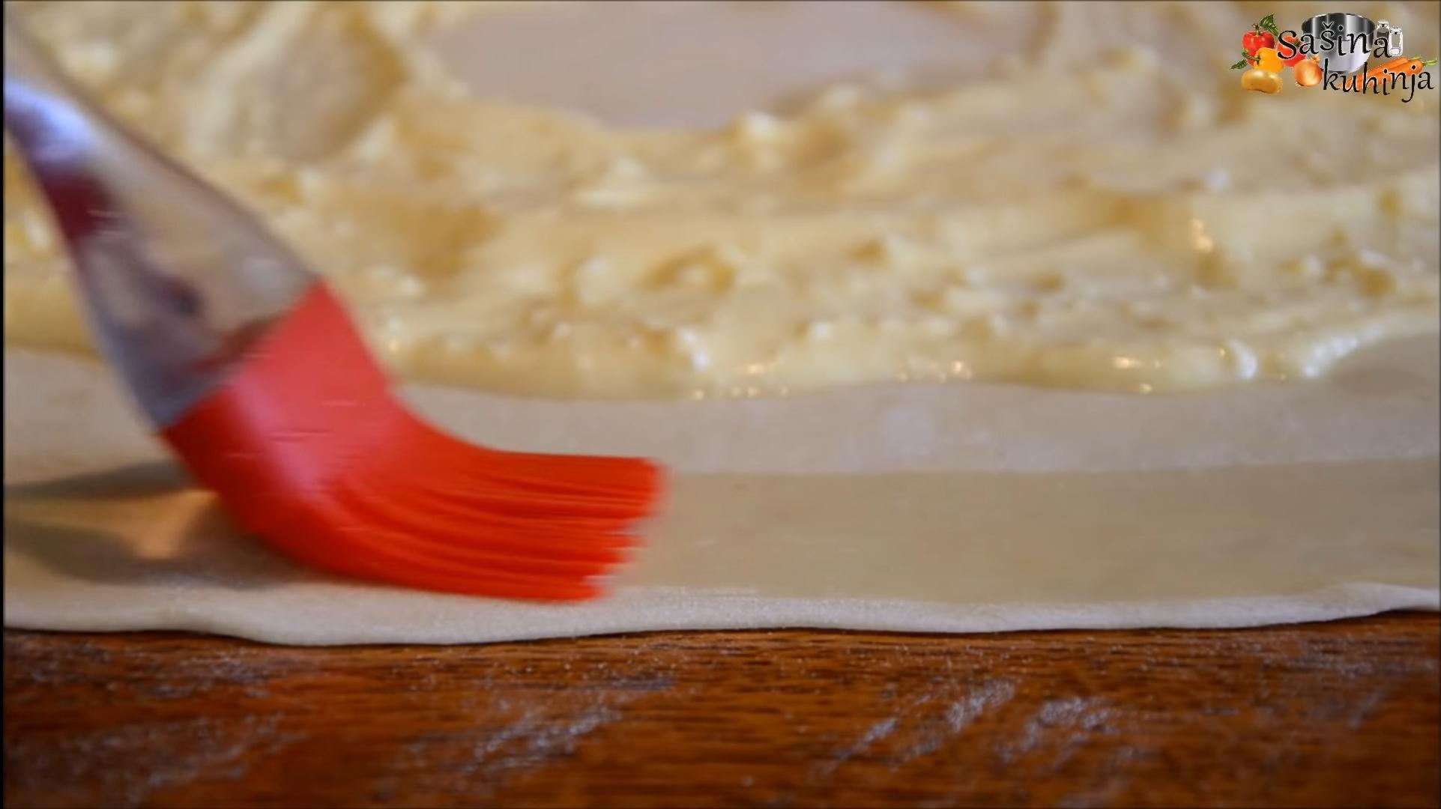
Fifth step
Roll the mixture over the dough in this way:
Coat the edges with water

Slide 9
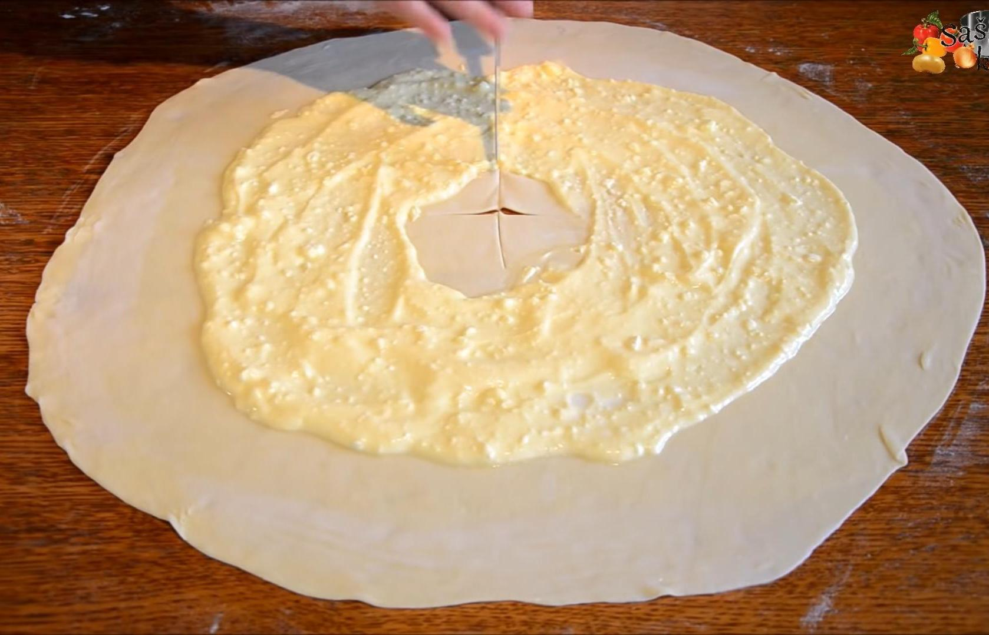
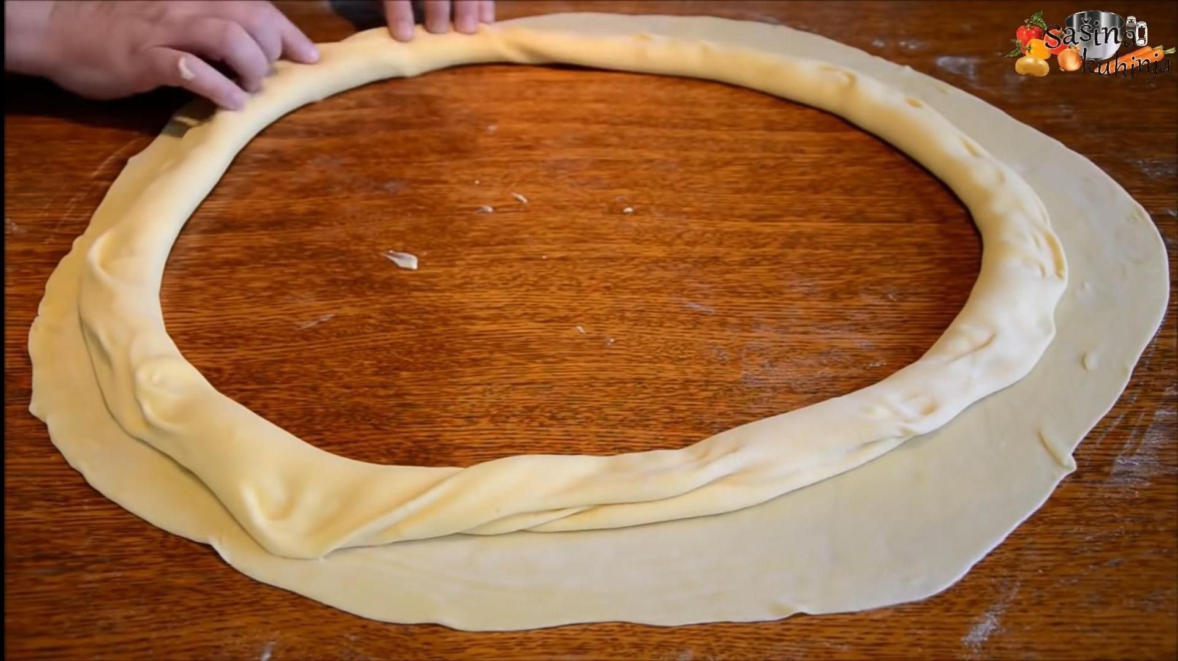
Sixth step
Make a cross with a knife in the middle where there is no cheese and pull the dough out from the inside out

Slide 10
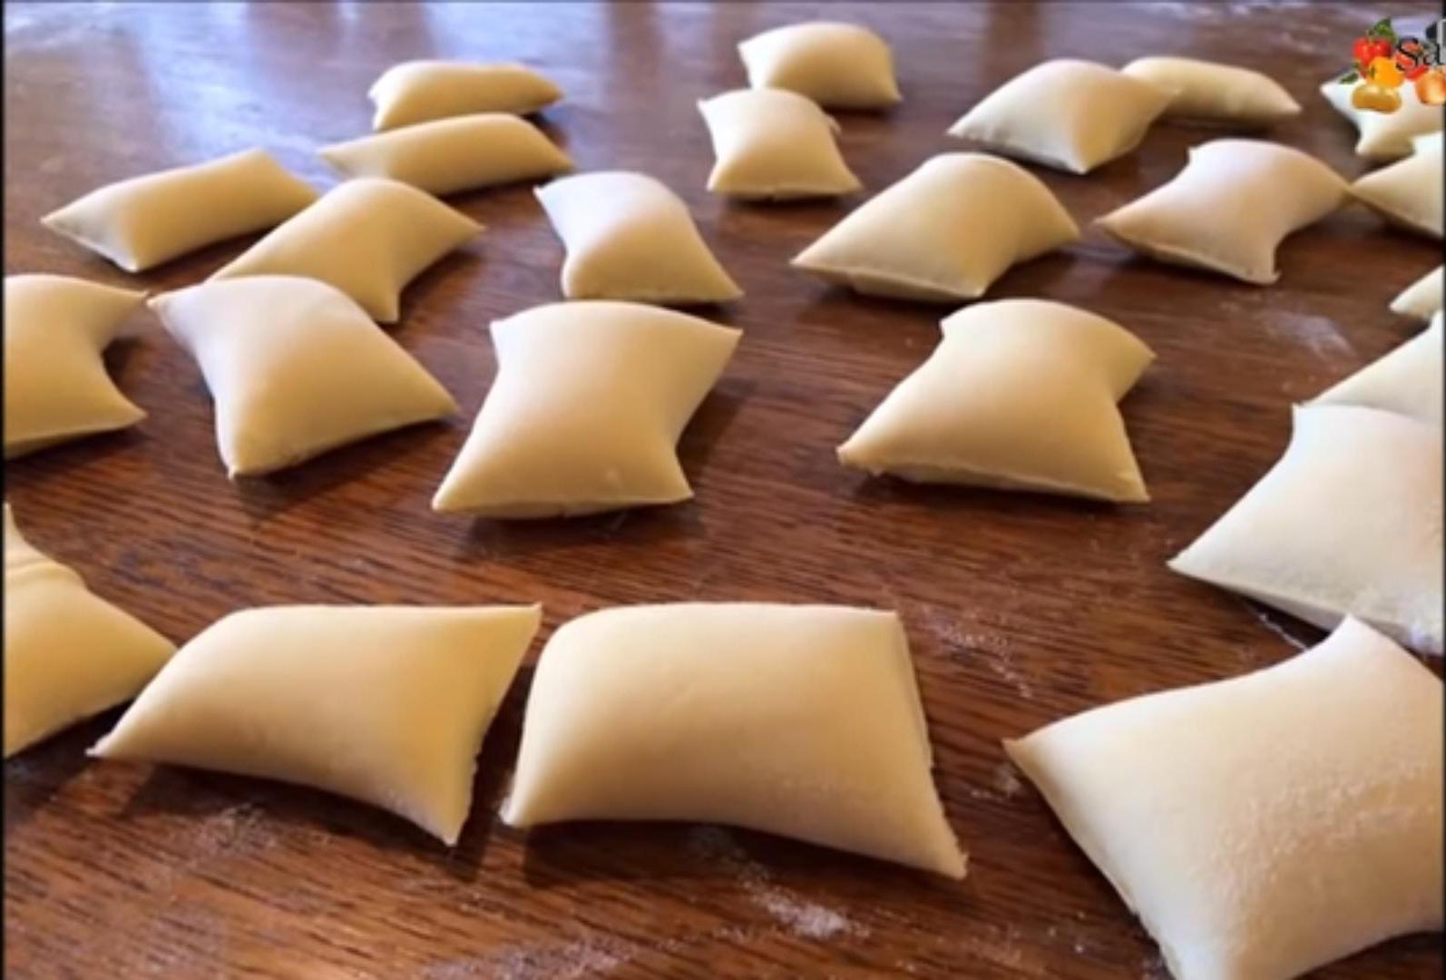
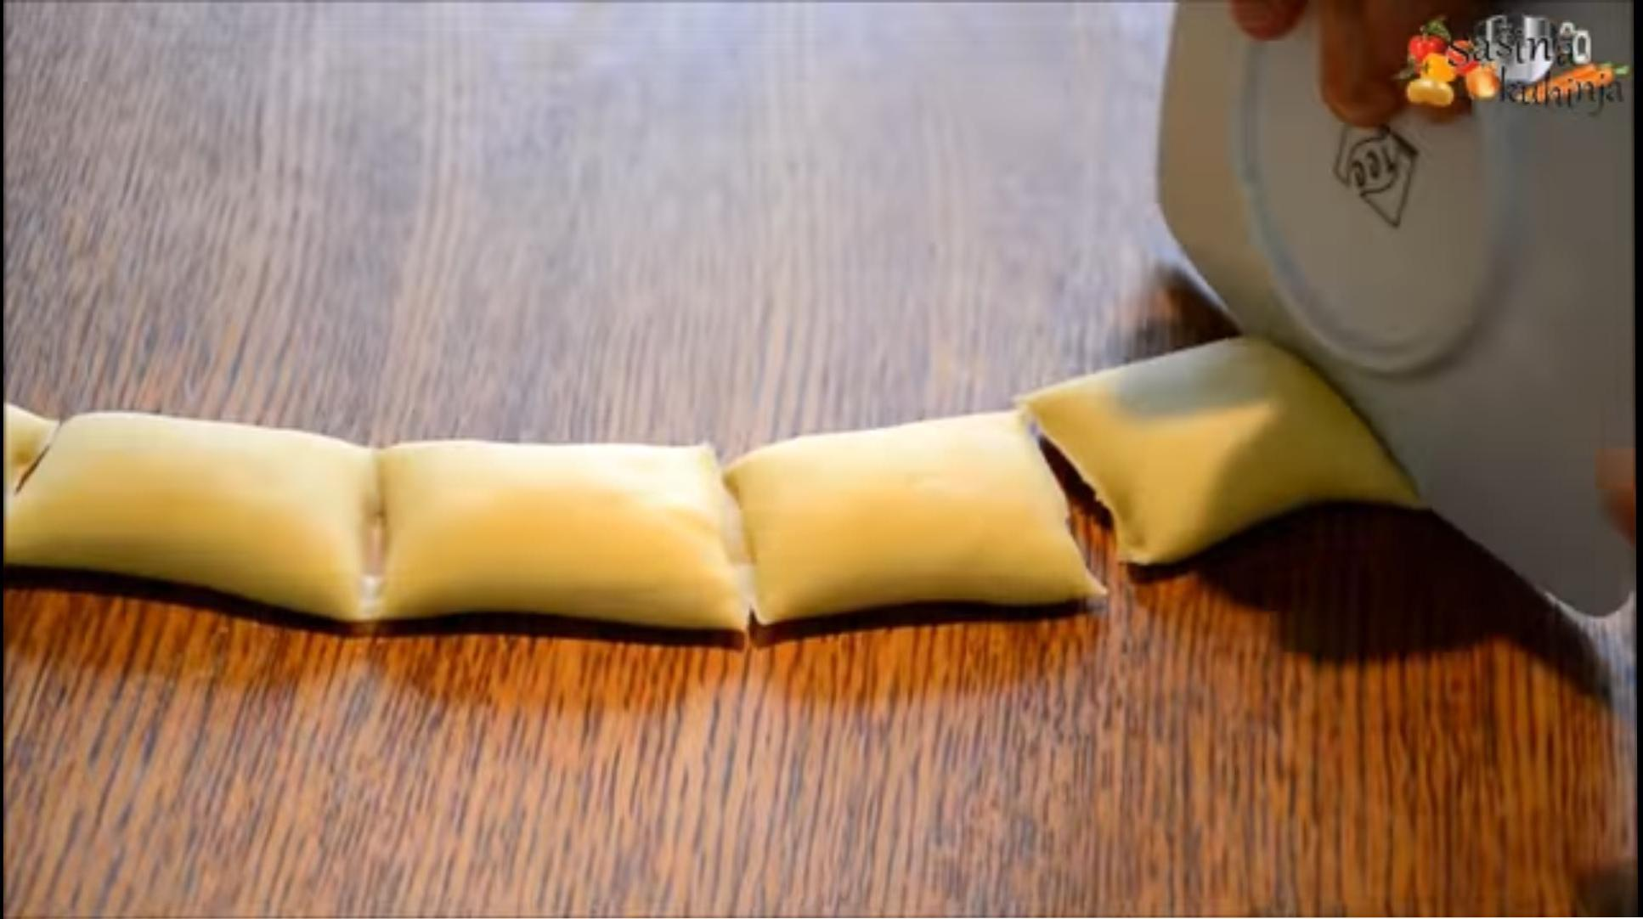
Seventh step
Leave for 5-10 minutes to rest before cutting
Be sure to cut with a saucer or something blunt of similar thickness
Cut pads the size of 10 centimetres

Slide 11
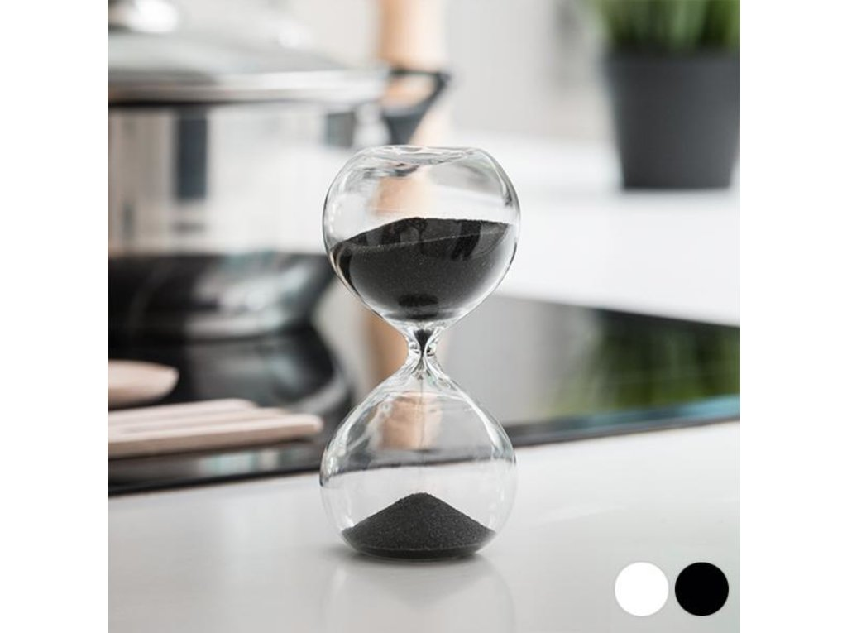
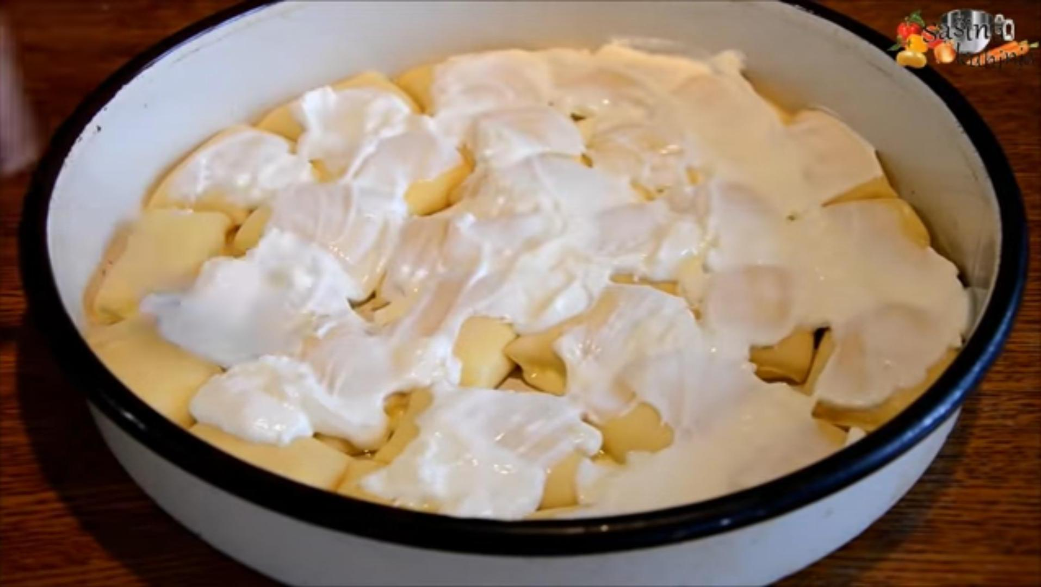
Eighth step
Coat the baking dish with oil and put them inside so that they evenly cover the entire surface of the dish
Finally put sour cream on them

Slide 12
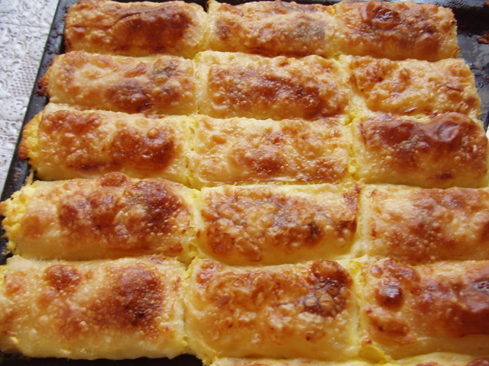
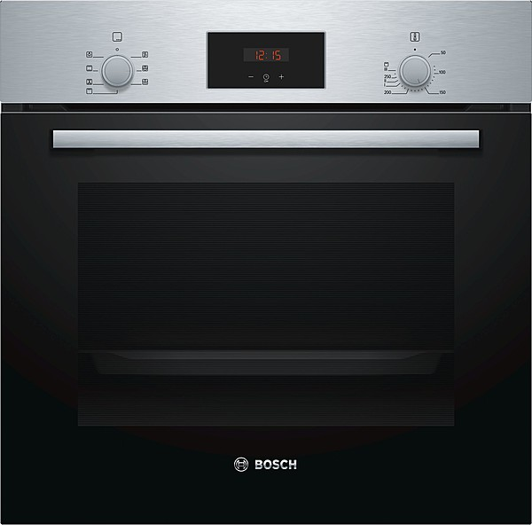
Ninth step
Put aluminum foil
Bake at 180°C for 45 minutes

Slide 13
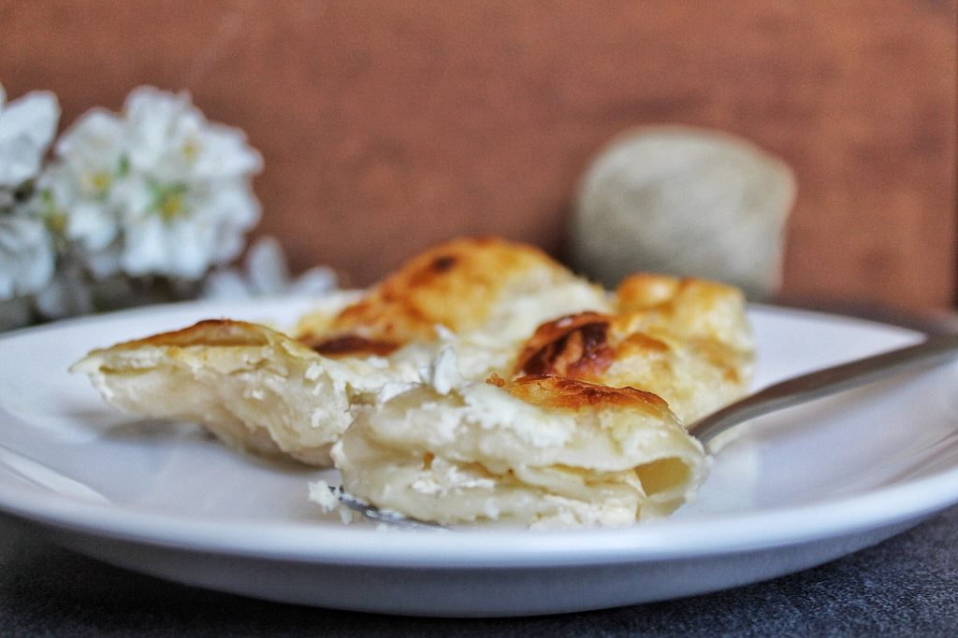
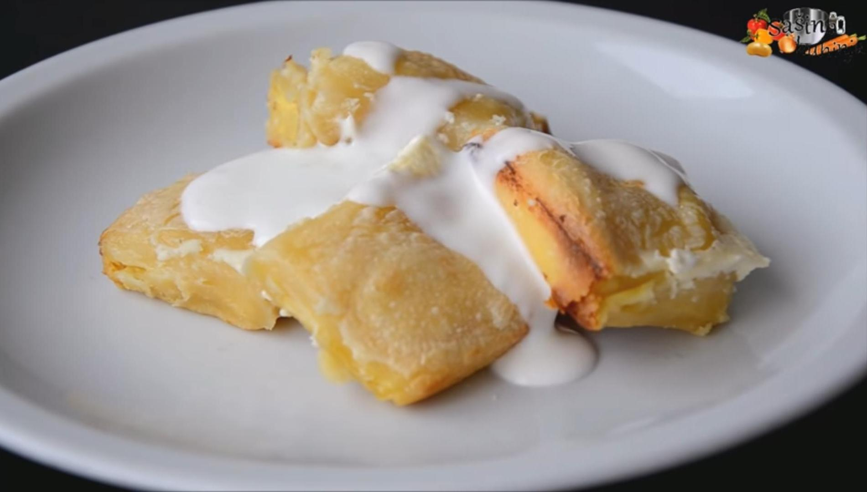
Tenth step
Bake for another 15 minutes at 200°C without foil
Serve as desired

Slide 14
Sources
Screenshots and recipe from the video: https://youtu.be/TqFOp9LrHhw
Other pictures:
https://images.app.goo.gl/QMmYBSMTvoYFn4pcA
https://images.app.goo.gl/fjS1vbRsMdAcSrKcA
https://images.app.goo.gl/3Hyr9azdHnWghG3w6
https://images.app.goo.gl/CrMshHiEfnqb6KYz9
https://images.app.goo.gl/77kFFwn974gHQ5wx9
https://images.app.goo.gl/gZqbanj84wfmBeci7

Slide 15
Good apetite
Ivana Batalić 7.a

