Slide 1
Life in the past
Petra Bačić

Slide 2
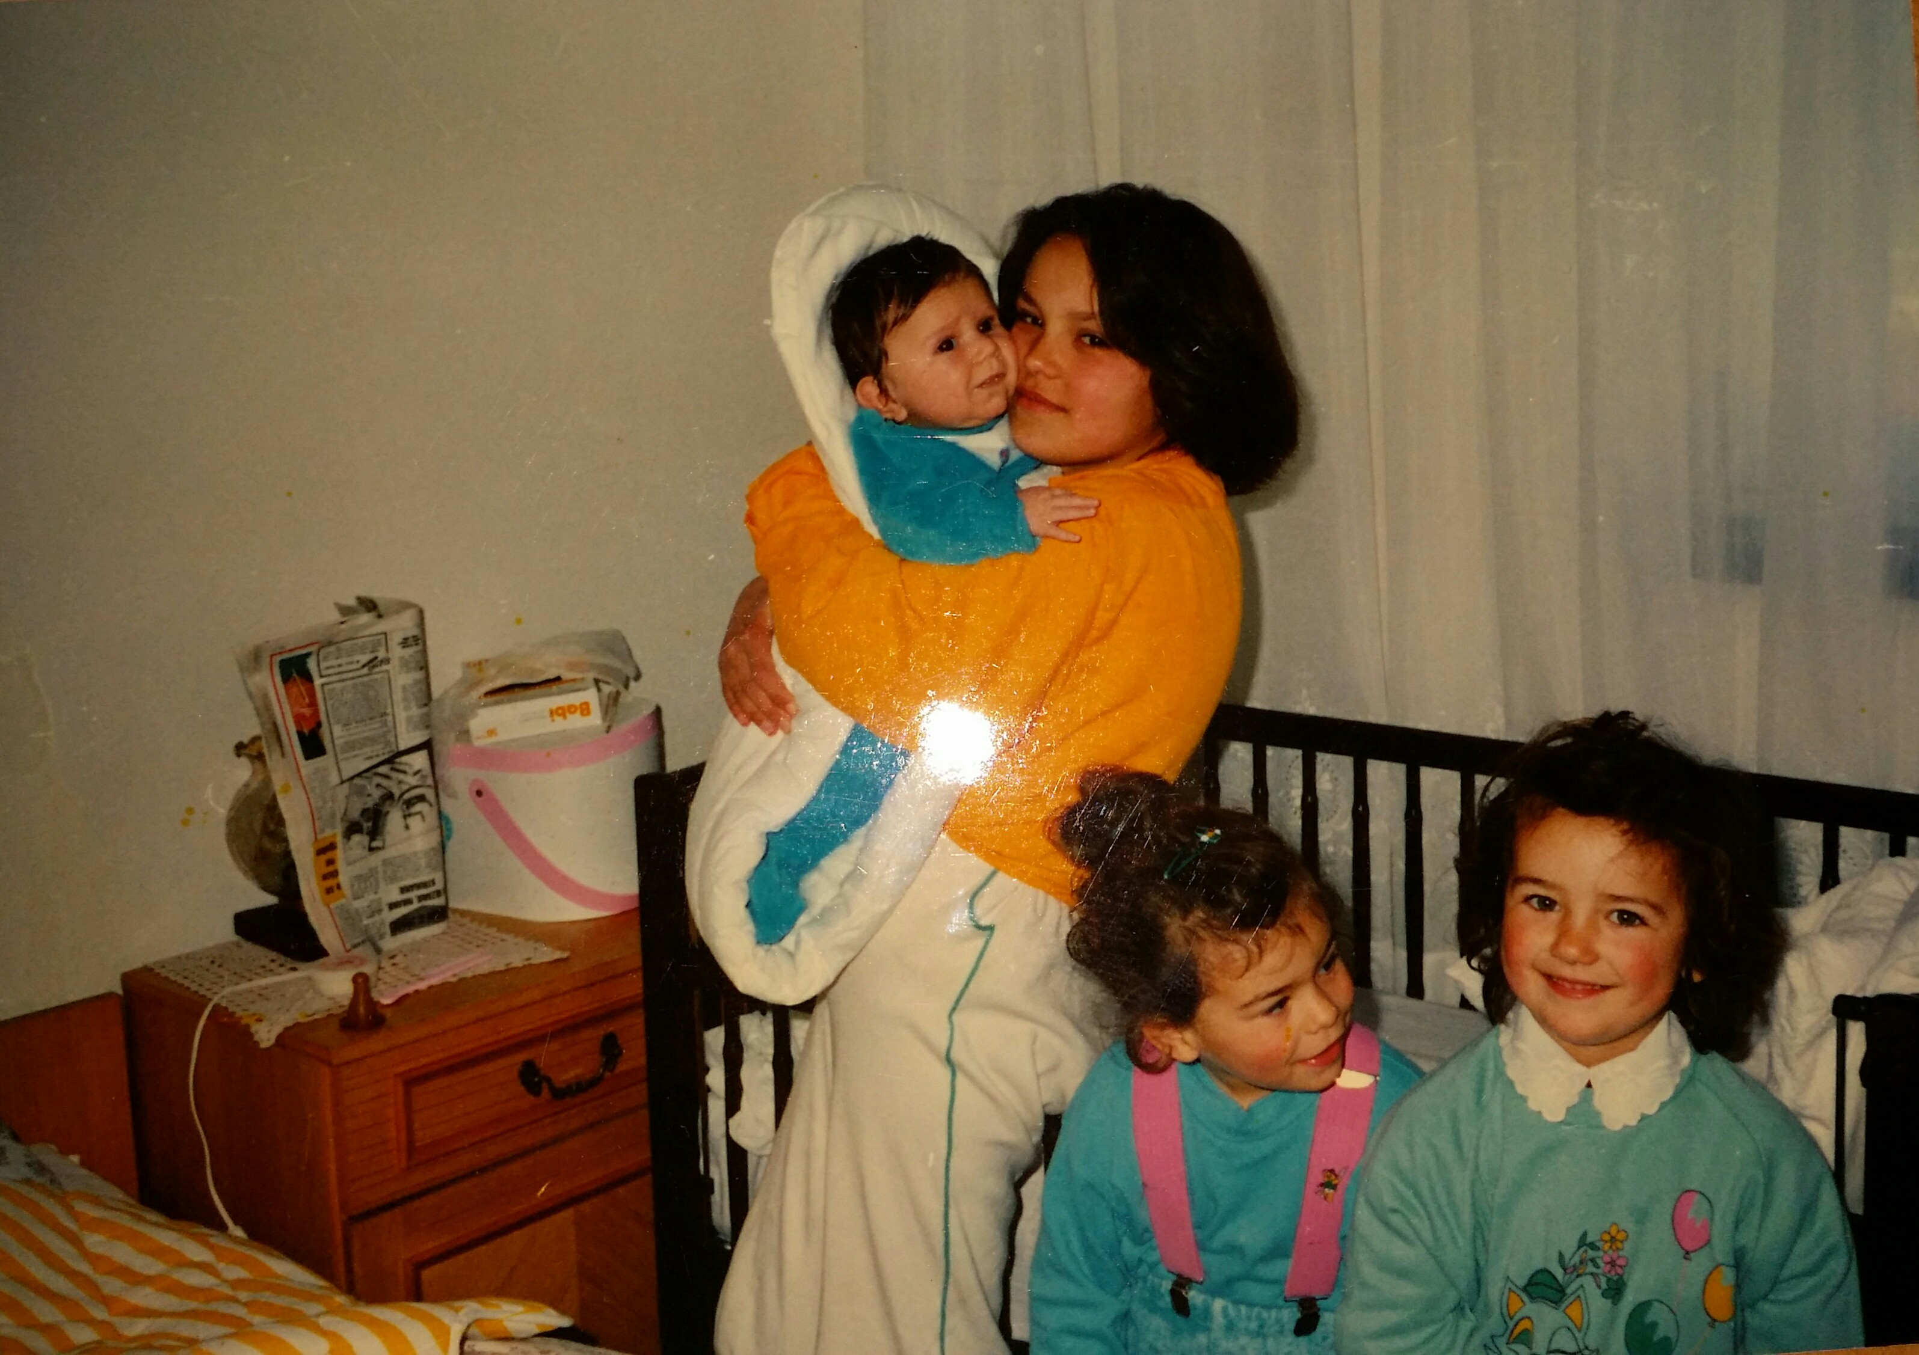
1. Did you live in a house or a flat?
My mom lived in a house,but my dad lived in a flat. My grandparents also lived in a house.

Slide 3
Did you have your own room?
My parents both had their own rooms. My mom shared her room with her sister but when they grew up they started having their own rooms.
My grandparents shared their rooms with their siblings.

Slide 4
Did you have a lot of clothes?
My mom had enough clothes and her mom always bought her something she liked. My dad didn’t have a lot of clothes. He wore something until he ripped it off and then he got the new clothes.
My grandparents didn’t have enough clothes.

Slide 5
Did you have any pets?
My dad had a cat and a bird. My mom had cats, birds and dogs.
My grandparents had cows,goats,chickens and many other farm animals.

Slide 6
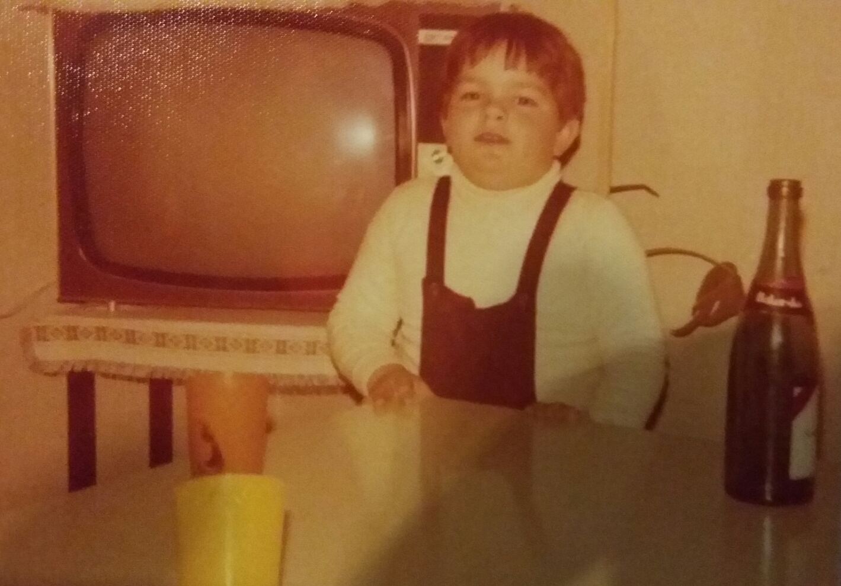
What time did you usually have lunch?
My dad had lunch when his parents got home from work. My mom and my grandparents had lunch around 12 pm.

Slide 7
What house chores did you have to do?
Mum helped her mom around the house(making the bed,washing the dishes…) and my dad had to wash the dishes.
My grandparents had to help their parents in the field and in the house.They also had to take care of farm and domestic animals.

Slide 8
What is your favourite dish from your childhood?
My mom liked the food that her grandma cooked, like donuts, and she loved to drink hot cocoa. My dad’s favourite dish was stew.
My grandparents loved when somebody came over and gave them sweets because in that time they didn’t really have that everywhere.

Slide 9
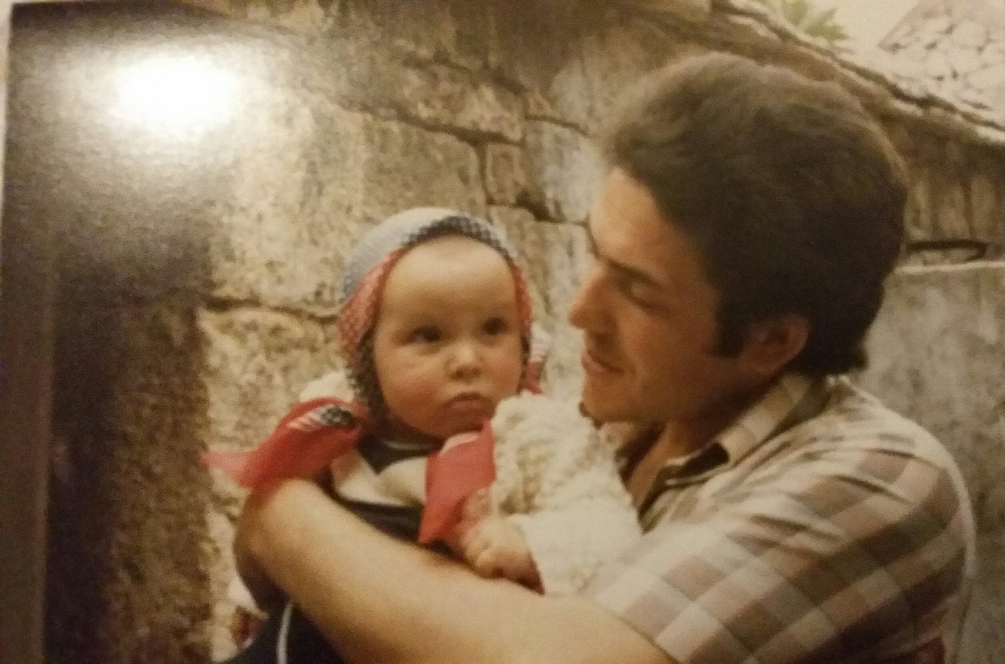
Did both of your parents work?
Both parents of my mom and dad worked.
My grandparents’ parents didn’t work.

Slide 10
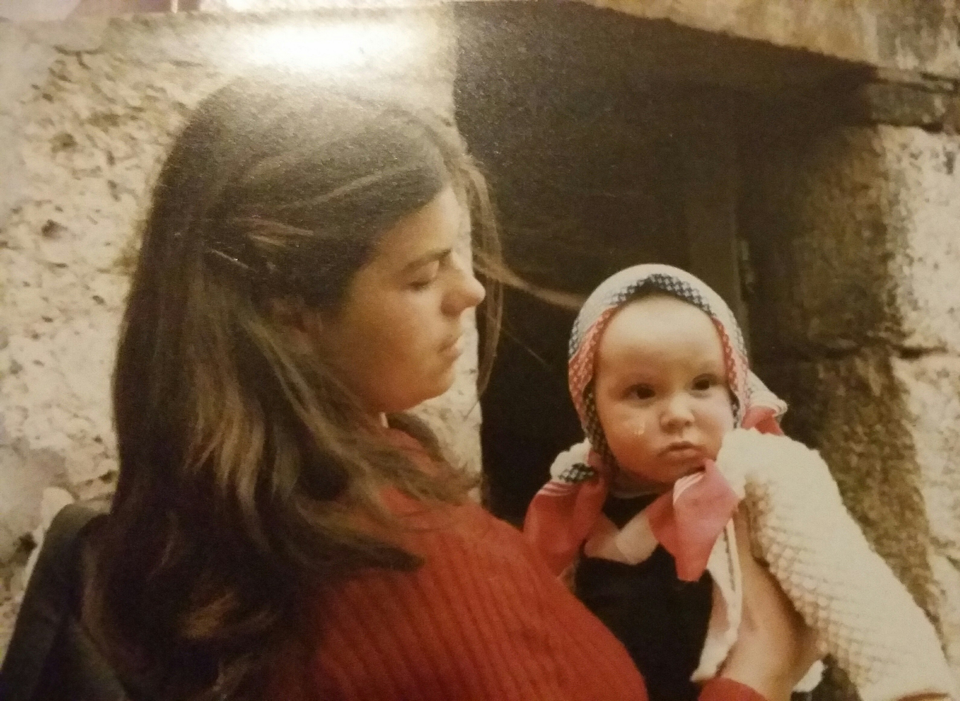
Did you have a car?
My parents have a car but my grandparents didn’t have a car.

Slide 11
How much time did you spend with your parents?
Both my mom and dad spent a lot of time with their parents but only when they weren’t working.
My grandparents spent more time with their parents than my mom and dad did.

Slide 12
Did your parents give you an allowance?
Mom didn’t really get an allowance from her parents because she always got what she wanted. My dad got an allowance for school and food.
My grandparents didn’t get an allowance.

Slide 13
Who did which household chores?
Mom made the beds,washed the dishes and she also did some easier stuff, while my dad washed the dishes and helped his parents.
My grandparents did a lot of chores like feeding and taking care of animals, washing the dishes,making the beds,cleaning and more.

Slide 14
What did you do during the weekend?
Mom and dad would both help ther parents and hang out with their friends during the weekend.
During the weekend my grandparents would take care of animals and go to church. My grandpa had a bike so he sometimes went to hang out with his friends and they visited many places.

Slide 15
What did you do and where did you go during the summer holidays?
My parents went to the beach. My dad lived near the sea so he didn’t really have to travel around.
My grandparents were always at home but my grandpa sometimes visited his aunt who lived in Split so he went to the beach. My grandma had a lot of cousins that lived in Split so she often visited them and went swimming.

Slide 16
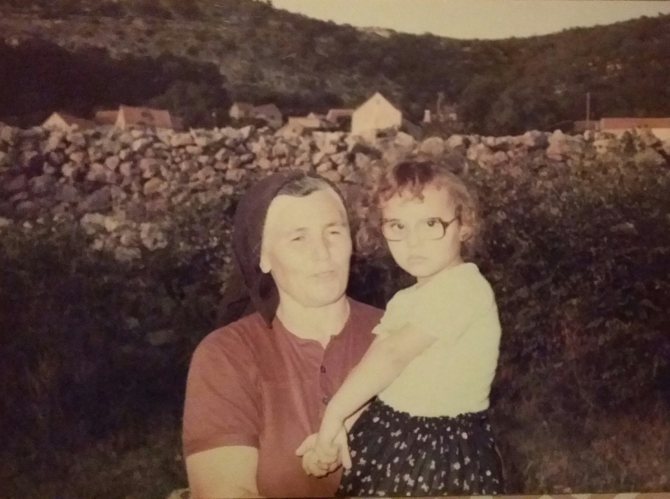
What kinds of music did you listen to?
Mom and dad both listened to what was popular at that time.
My grandparents listened to folk songs.

Slide 17
Where and how did you listen to music?
My parents listened to it on the radio, tv and Walkman.
My grandparents didn’t have anything for listening to music.They only listened to their parents or grandparents singing some songs and then they learned it.

Slide 18
How many hours a day did you watch tv?
My parents usually watched TV in the morning and in the evening because they were outside the whole day. There weren’t a lot of cartoons on TV at that time.
My grandparents didn’t have TV.

Slide 19
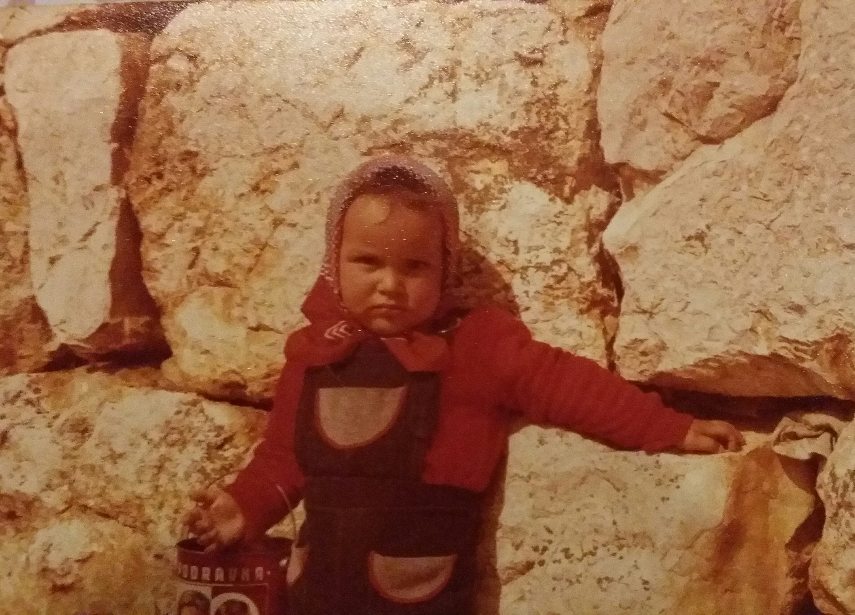
How often did you go to the cinema?
My mom and dad didn’t really go to the cinema and my grandparents never went to the cinema.

Slide 20
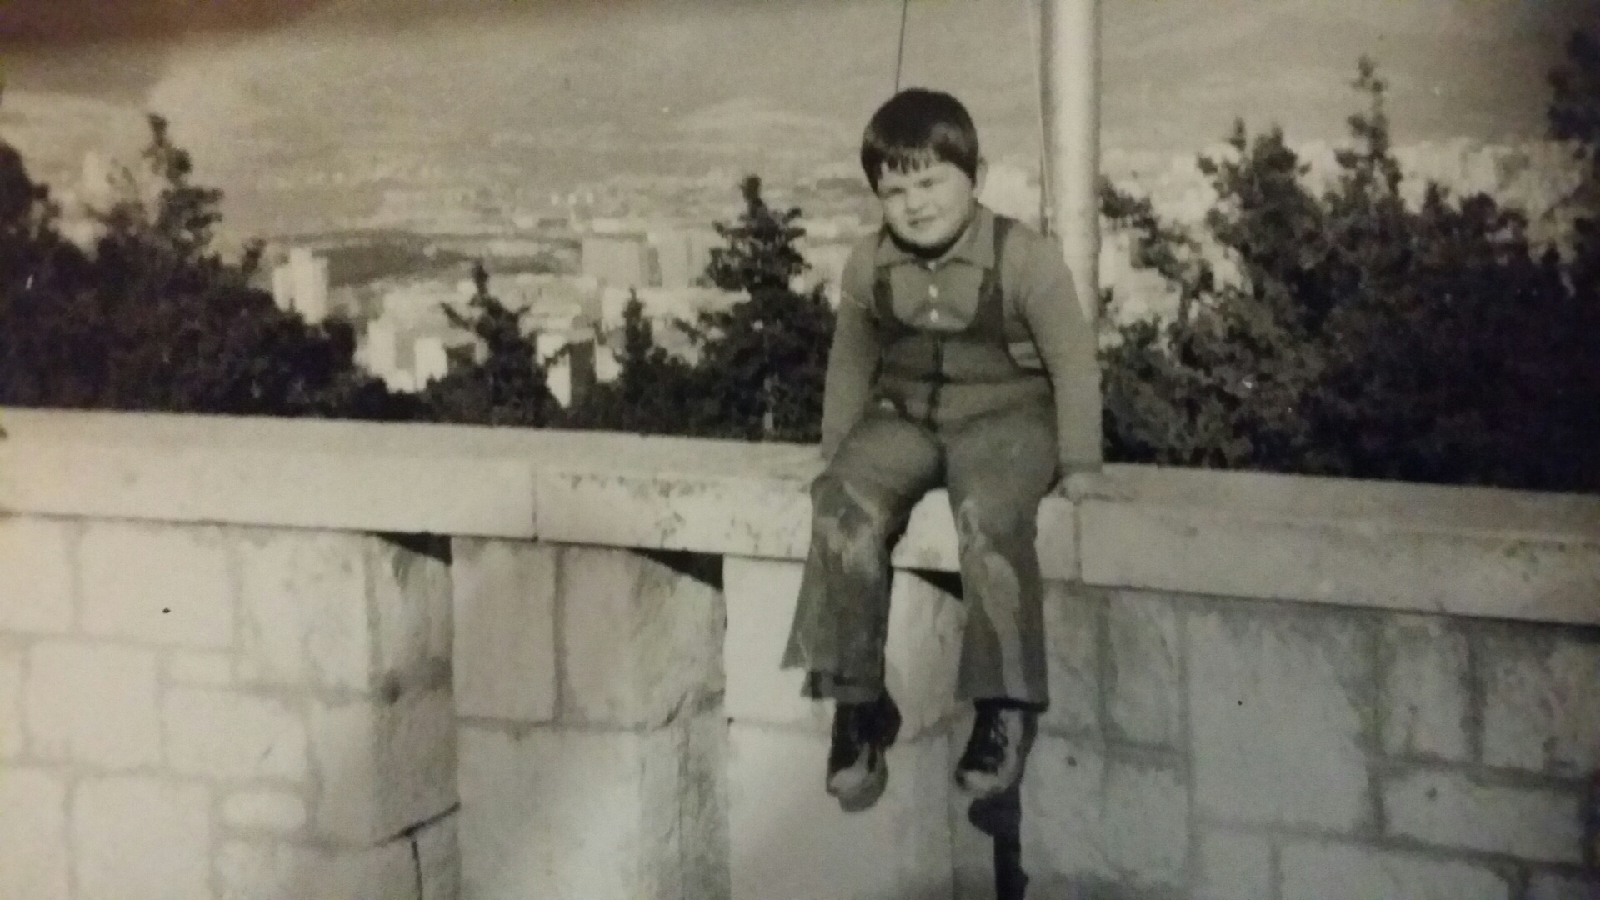
What were you worried about?
Mom didn’t really worry about anything and so didn’t my dad or my grandparents.

Slide 21
What made you happy?
All of them were happy when they hung out with their friends enjoying their free time.

Slide 22
What was your biggest dream?
At that time my parents didn’t really think about that. My grandpa’s biggest dream was to drive trucks and busses. My grandma wanted to have a happy family.

Slide 23
The end!

