Slide 1
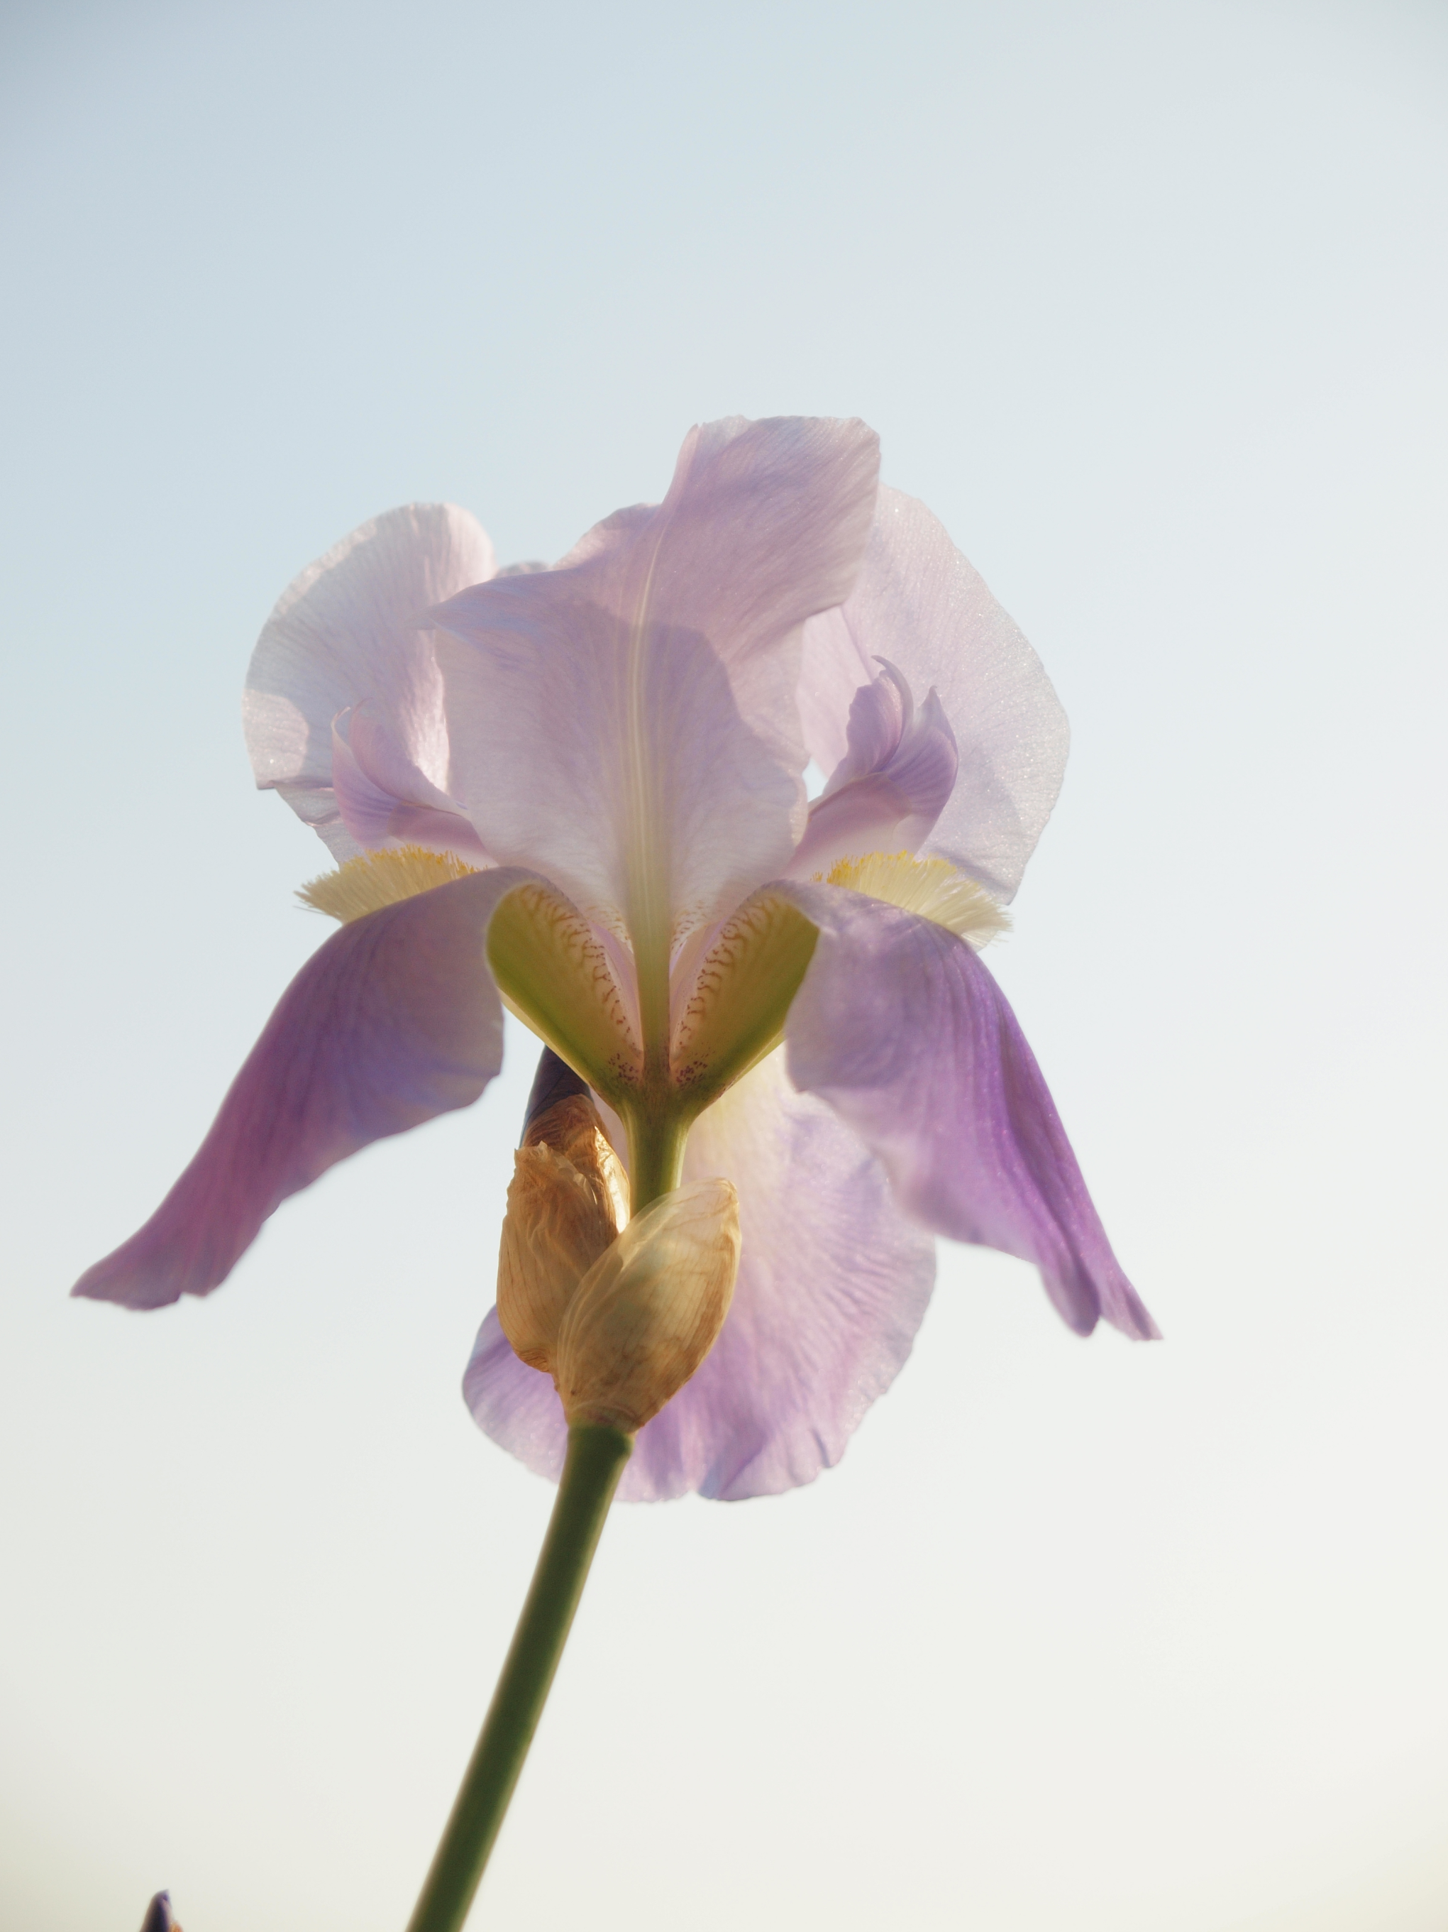
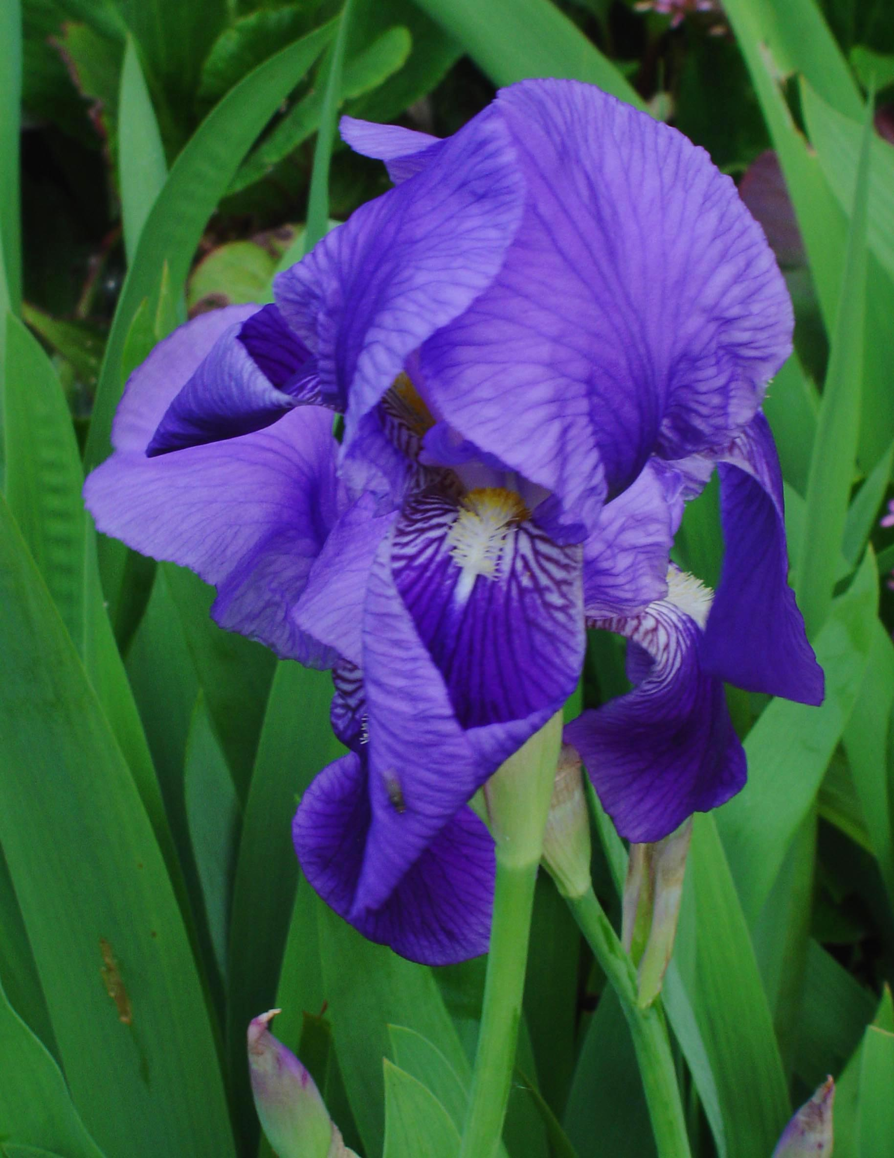
Illyrian iris ع˖⁺୭ croatian national flower
Cvita Grubišić ✩•̩̩͙*ೃ
◣ 7.b. ◥

Slide 2
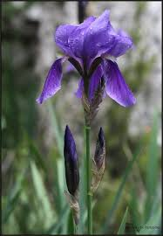
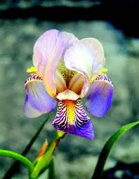
The basics ◃ ۪۪۫۫ ༄ ˑ
from the iris family (Iridaceae)
a perennial plant (lives more than two years)
native in Southeastern Europe, mostly found in the ancient region of Illyria
can be found growing wild in modern Slovenia, Dalmatia, Albania, Kosovo, Bosnia and Herzegovina, Montenegro, parts of Serbia and North Macedonia

Slide 3
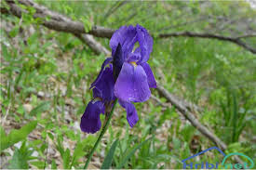
-ˋˏ✄ ----- description
in Latin known as Iris illyrica
grows up to 40 centimeters in height
blooms during May and June
rarely produces seeds and if it does, their number is usually around ten
the said seeds rip out in autumn
often treated as the subspecies of Dalmatian iris (Iris pallida)

Slide 4
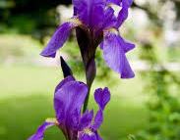
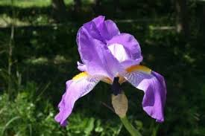
⚘ Iris as croatian national flower ⚘
became Croatian national flower back in 2000.
twelve iris species existing in Croatia: Croatian iris or bearded iris (Iris croatica), Iris adriatica, Illyrian iris (Iris illyrica), southern adriatic iris (Iris pseudopallida) etc.
most of Croatian iris species are endemic

Slide 5
Iris in history ⊰⊰
Illyrians (later Romans) considered irises medical herbs, used as relief of headaches
symbol of royal power and god's protection in many cultures
ancient Greek goddess of the rainbow Iris made irises grow in the places where rainbows end
pharaon Thutmose III. had iris flowers drawn on his palace's walls
Croatian name for iris originates from the Slavic god Perun and his wife Peruna/Perunitsa

Slide 6
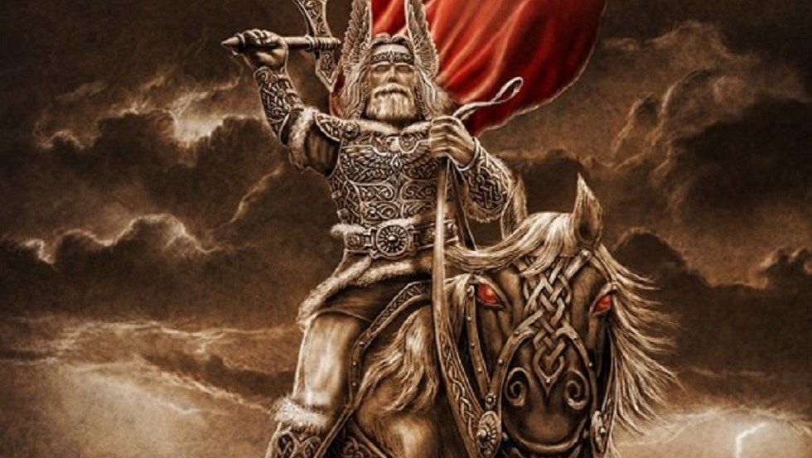
Perun,the slavic god of thunder ༺
god of the sky, thunder, lightning, storms, rains, law, war, fertility and oak trees
married to Peruna/Perunitsa, the daughter of Diviya (goddess of the moon) and Dy (god of the starry night and thunder)
Peruna's/Perunitsa's actual name is Diva/Dodola
it was believed that where Perun's thunder lands, an iris grows, each time in a different color

Slide 7
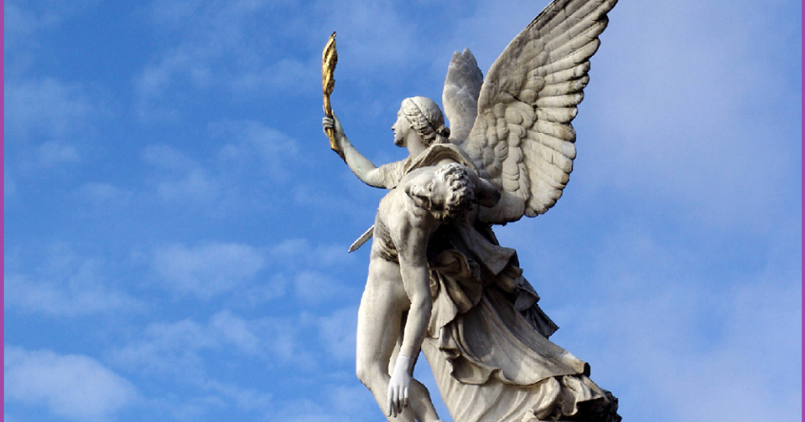
Iris, the greek goddess of rainbow ┉༝✧
goddess of rainbow and a messenger of Olympian gods
daughter of Thaumas (sea god) and Oceanid Electra and sister of Aello and Ocypete (the Harpies)
married to Zephyrus (god of the west wind)
irises grow where rainbows end
irises were actually named after her

Slide 8
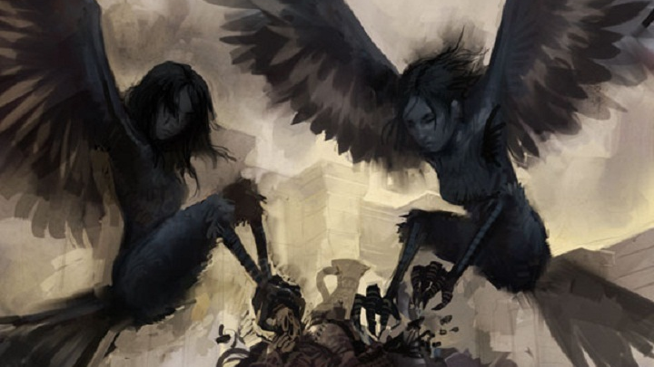
The harpies, aello and ocypete ◥
half women half bird, described as ugly and pale, always hungry and long claws on their hands
daughters of Thaumas (sea god) and Oceanid Electra and sisters of Iris (goddess of rainbow)
known as ''ministers of the Thunderer (Zeus)
would steal food from evildoers and capture them, taking them to the Erinyes (who will punish them for their crimes)

Slide 9
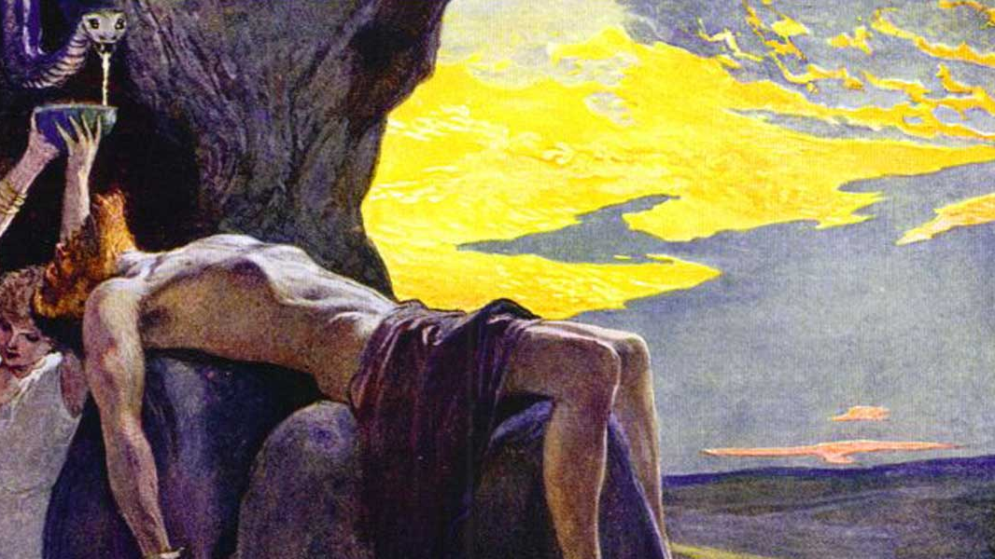
Sigyn, the nordic goddess of victory তত
goddess of victory and a member of principle pantheon of Nordic gods (Æsir)
wife of Loki (god of trickery) and mother of Nari and Váli
underrated and not known compared to her husband
not much is known about her
irises are related to her, with acacias, lilacs, honeysuckles, cyclamen, mimosa

Slide 10
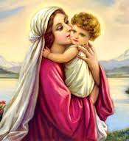
Irises in the bible ༄
along with white lily, irises are dedicated to Virgin Mary since one of it's meanings is purity
other meanings of irises are wisdom, hope, trust, valor, royalty, passion, faith
sometimes associated with Passion of Christ and the Resurrection, since they bloom around Easter
the first Christian king of France, Clovis, made it the national flower and the flower of victory

Slide 11
✧ThÉ end✧

