Slide 1
Dalmatian blade
Dora Jurić
7.b

Slide 2
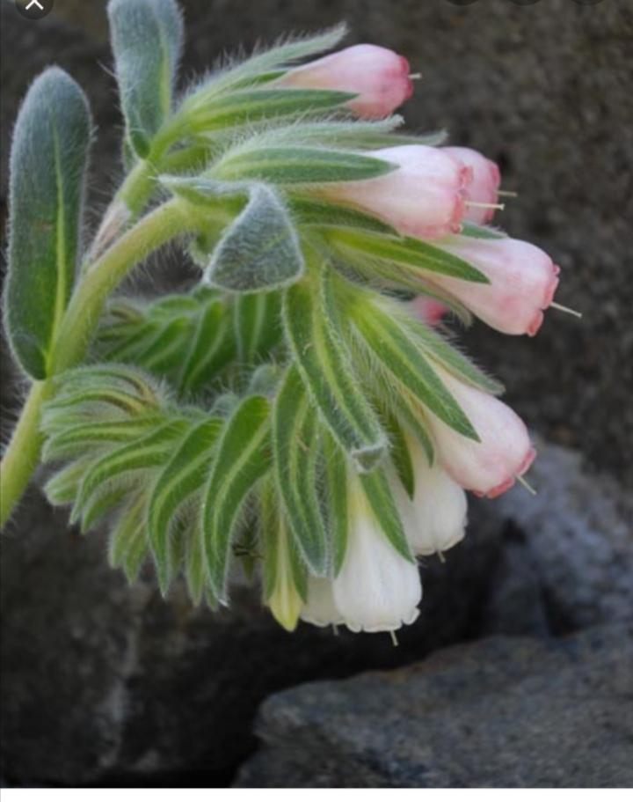
Features of Dalmatian blade
-The stem and leaves are hairy.
-In June and July they bloom with yellow flowers.
-In the past, red was obtained from its roots, so it is also called blusha.
-Dalmatinian blade grows in Dalmatia.

Slide 3
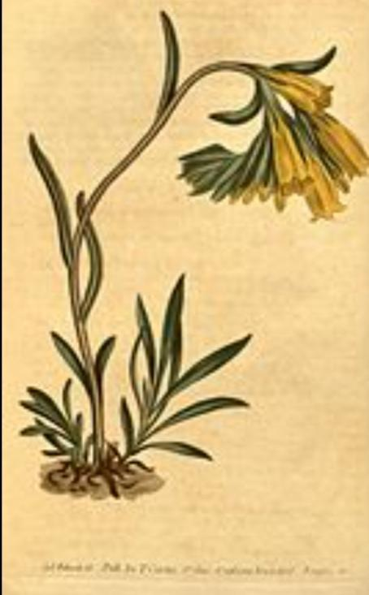
Fact 1.
-Oštrika (Oštrolist, lat. Onosma),
-increase plant yield of annual and biennial vegetation
- several species and subspecies of blades, often called sharp-edged,grow in Croatia

Slide 4
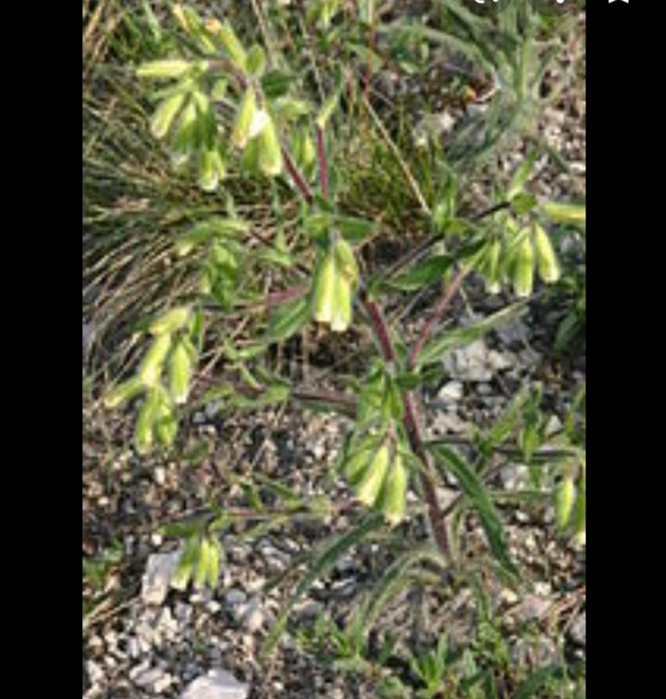
Fact 2.
-Knowable species and subspecies from Croatia are:
Dalmatian sharp-edged Visionian blade (Onosma visianii) - subspecies
Biokovo blade

Slide 5
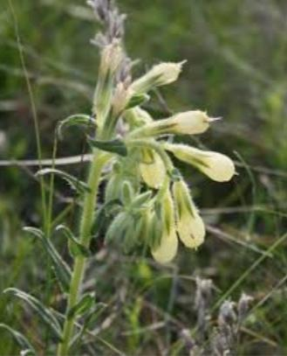
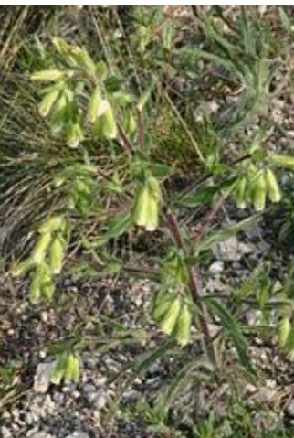
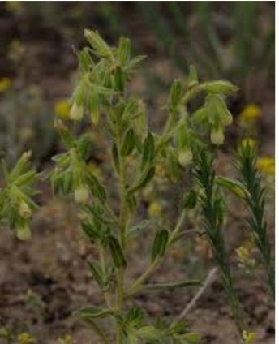
Pictures of Dalmatian blade (dalmatinska oštrika)

Slide 6
The end

