Slide 1
Halloween Davor Mihovilović 5.a

Slide 2
What is Halloween?
Halloween is a holiday celebrated each year on October 31, and Halloween 2020 will be on Saturday, October 31.
It is celebrated in many countries in Europe and around the world, but it is most popular in the USA.

Slide 3
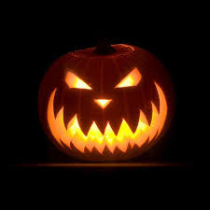
BUH!
Pumpkin is a symbol of Halloween.
It is called Jack o´Lanterns.
It is a very scary pupmkin.

Slide 4
TRICK OR TREAT
What does TRICK OR TREAT mean?
to trick – to make a joke or prank someone
treat – something sweet or nice, like a candy

Slide 5
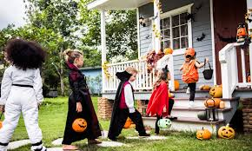
TRICK OR TREAT Children wear scary costumes..... Chidren go from door to door and knock.. When somebody opens they shout: “TRICK OR TREAT!?” The people in the house give them sweets.. It is American tradition.

Slide 6
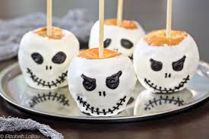
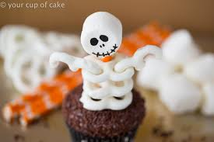
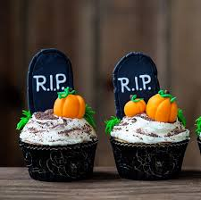
HALOWEEN TREATS
Toffe apples
Sweets

Slide 7
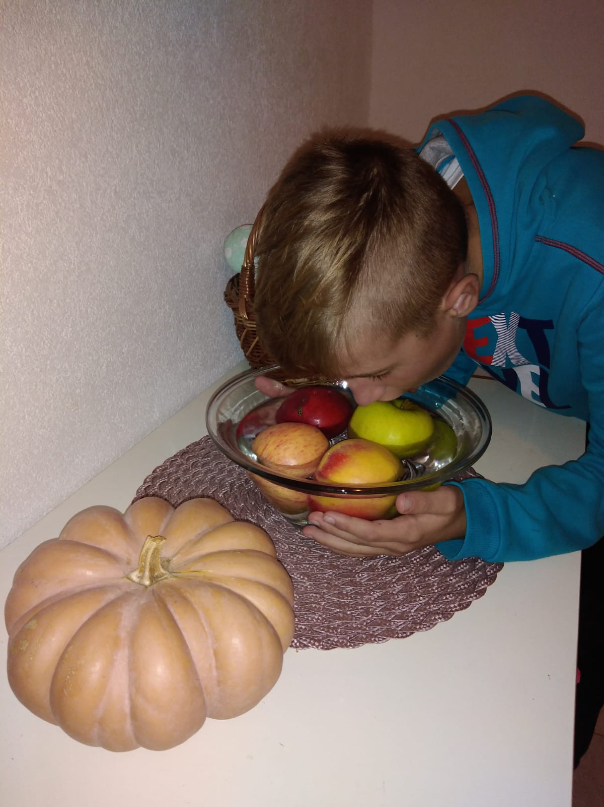
HALOWEEN GAMES
I like apple bobbing beacuse it is
very funny.

Slide 8
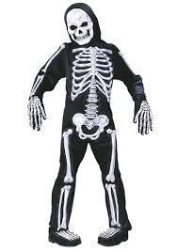
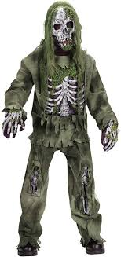
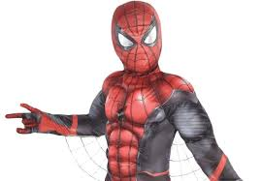
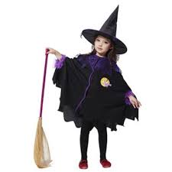
Halloween costumes
Witch and vampire costumes are popular at Halloween.
Some other popular costumes are superhero costumes.

Slide 9
Happy Halloween! Thank You

