Slide 1
HALLOWEEN

Slide 2
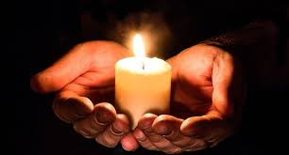
ABOUT HALLOWEEN…
Halloween is on 31st October.
It is also known as Allhalloween, All Hallow Eve, or All Saints Eve.It is a festivity celebrated in many countries (Usa,Canada,Puerto Rico,Australia and New Zeland) on that date.
All Saints’ Day is a day when we remember our loved ones who have died.

Slide 3
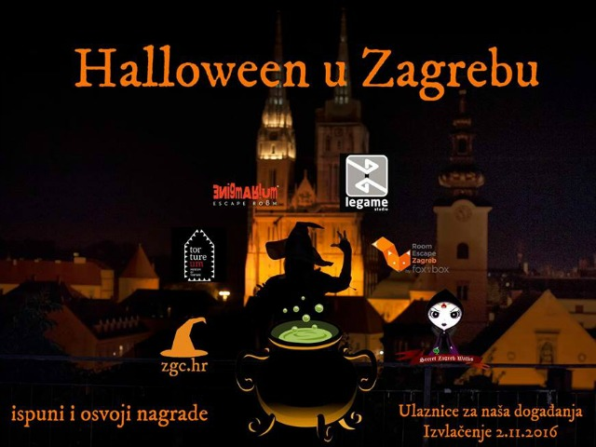
Situation in croatia
Halloween is not celebrated in Croatia.
We celebrate All Saints Day.
But,some people in Croatia celebrate Halloween.

Slide 4
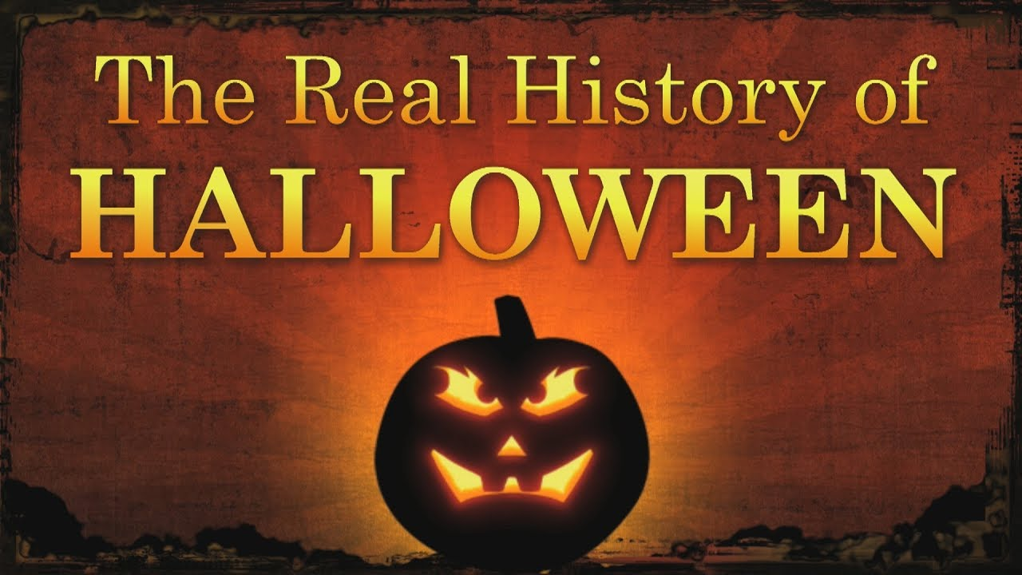
What is the real origin of Halloween?
Halloween's origins date back to the ancient Celtic festival of Samhain (pronounced sow-in). The Celts, who lived 2,000 years ago, mostly in the area that is now Ireland, the United Kingdom and northern France, celebrated their new year on November 1.

Slide 5
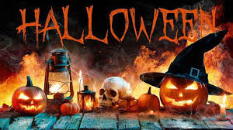
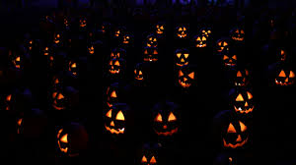
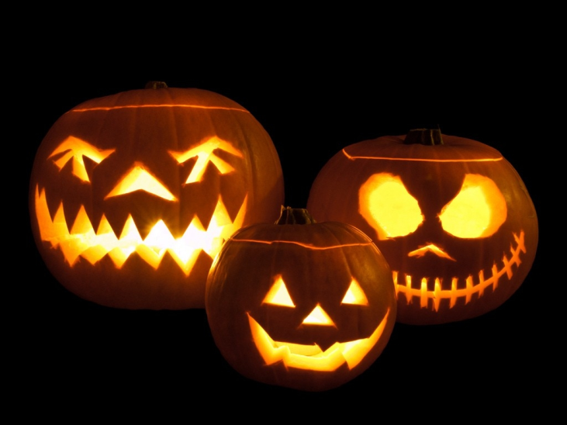
Halloween pumpkins

Slide 6
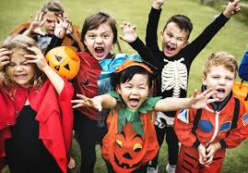
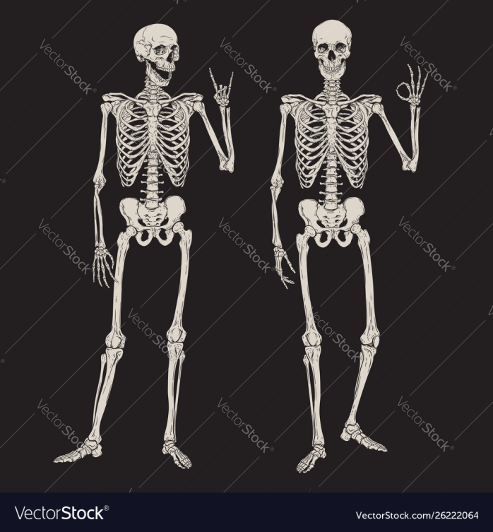
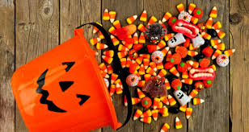
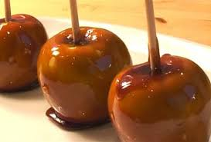
At this time of year, Jack o’ Lanterns and skeletons are all around.
Some tasty Halloween treats are sweets and toffee apples.
Parties and ‘trick-or-treating’ are funny Halloween activities.
Halloween sweets
Skeletons
trick-or-treating
toffee apples

Slide 7
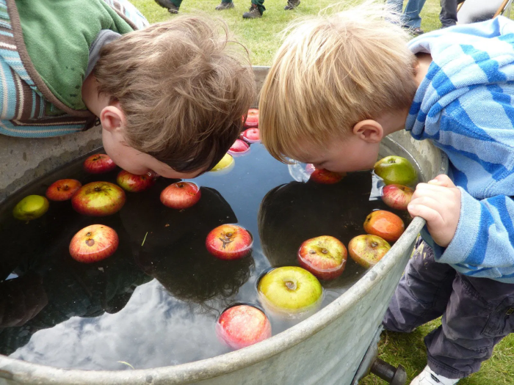
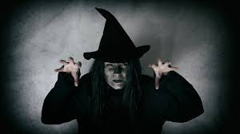
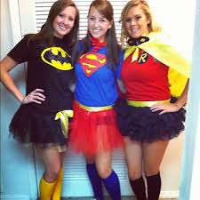
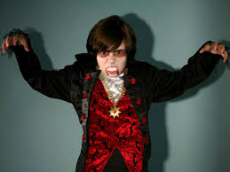
Games like bobbing for apples are great,too!
Witch and vampire costumes are popular at Halloween.
Some other popular costumes are superhero costumes.

Slide 8
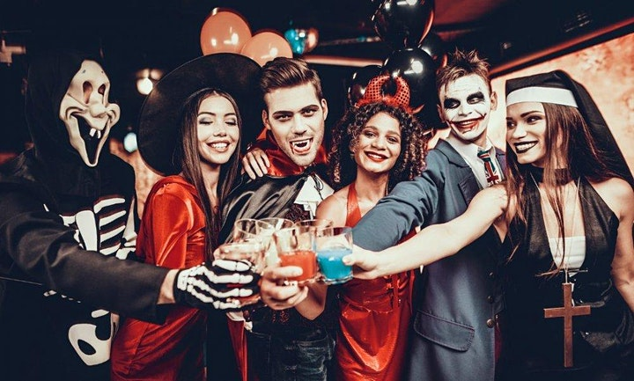
Halloween party

Slide 9
thank you for attention!
Margarita Valenta 5.a

