Slide 1
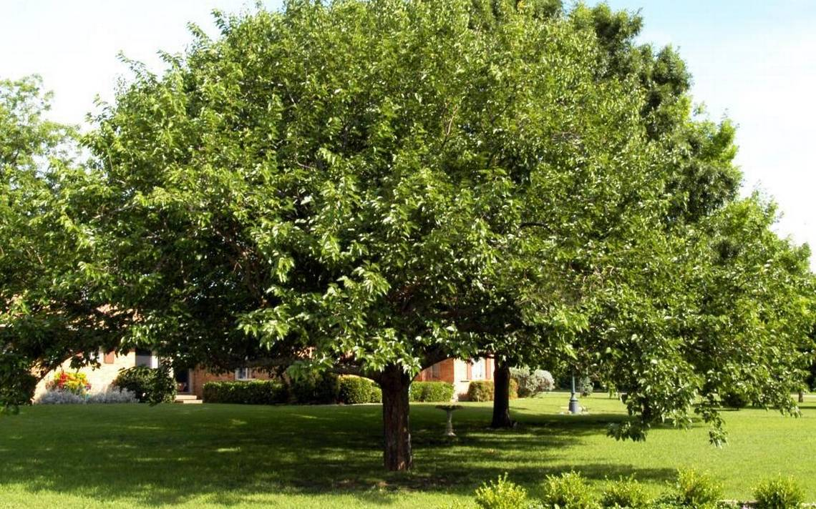
Mulberry
Mulberry

Slide 2
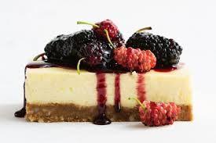
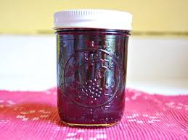
You can make mulberry cakes and marmelade

Slide 3
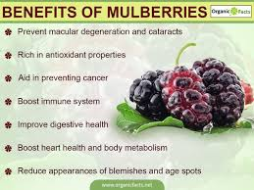

Slide 4
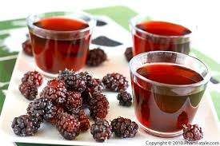
Mulberry juice is very healthy and nice

Slide 5
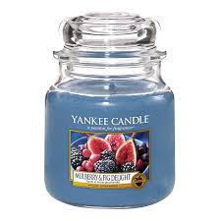
There are scented mulberry jar candles

Slide 6
Made by Špiro Perković, Roko Perković, Mateo Uvodić and Dominik Bubić

