Slide 1
mulberry

Slide 2
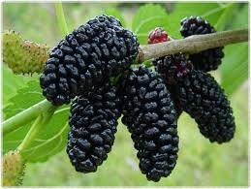
Dud or Mulberry is a medium sized tree, of 6 to 15 meters high, spread in all moderate and subtropical regions of the north, except Europe.

Slide 3
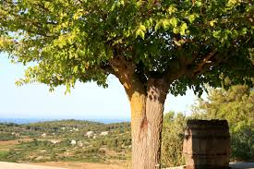
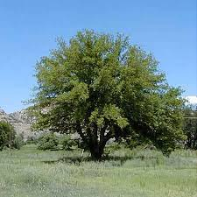
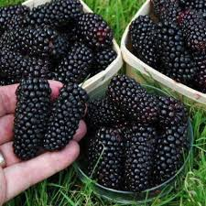

Slide 4
They grow on poorer soils, predominantly sandy, their crown is branched as well as roots. The fruits are aromatic and very tasty, 2 to 3 cm in size, white, purple and pink to red.

Slide 5
