Slide 1
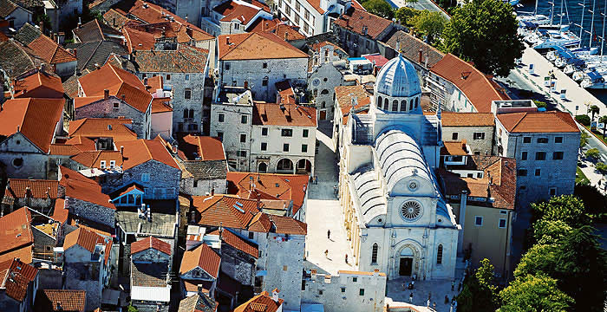
ŠIBENIK

Slide 2
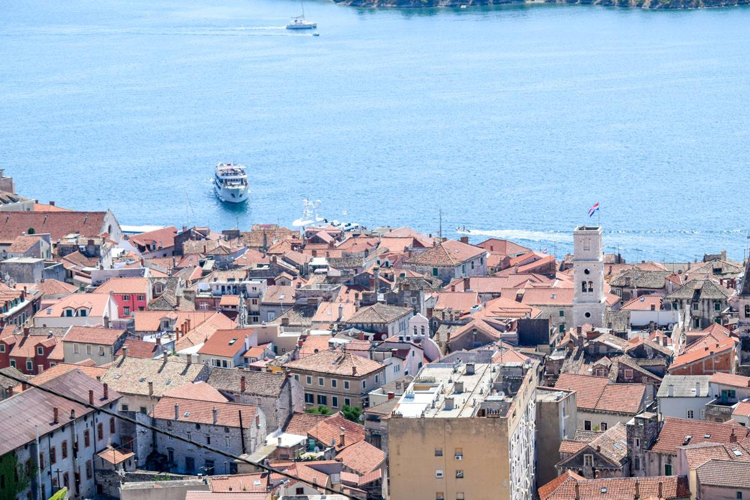
History of Šibenik
Šibenik stands out from all the Croatian towns on the Adriatic, with its unique position in a picturesque and spacious bay at the mouth of the river Krka
Šibenik is mentioned for the first time in 1066 in the title of the most important ruler of the Croatian state - King Petar Krešimir IV. Šibenik

Slide 3
Šibenik cathedral of Sv.Jakova The only building in Europe is exclusively of stone 105 years of construction Masters: Juraj Dalmatinac and Nikola Firentinac There is 71 realistic portraits of the apses.
CATHEDRAL

Slide 4
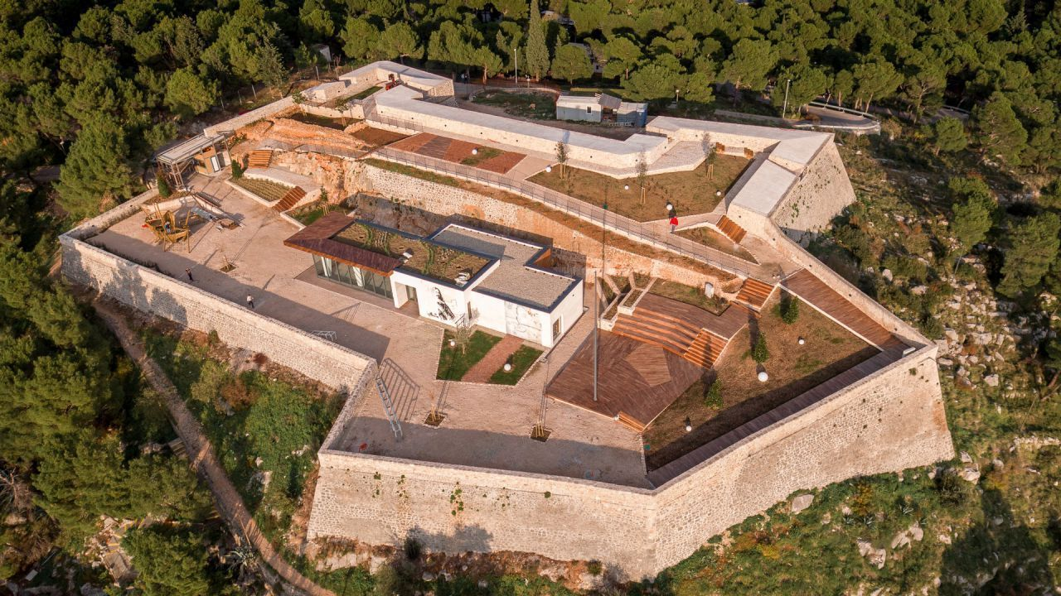
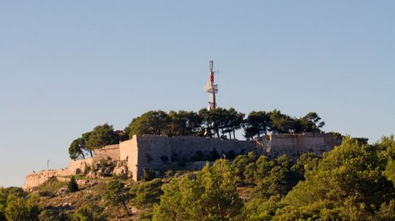
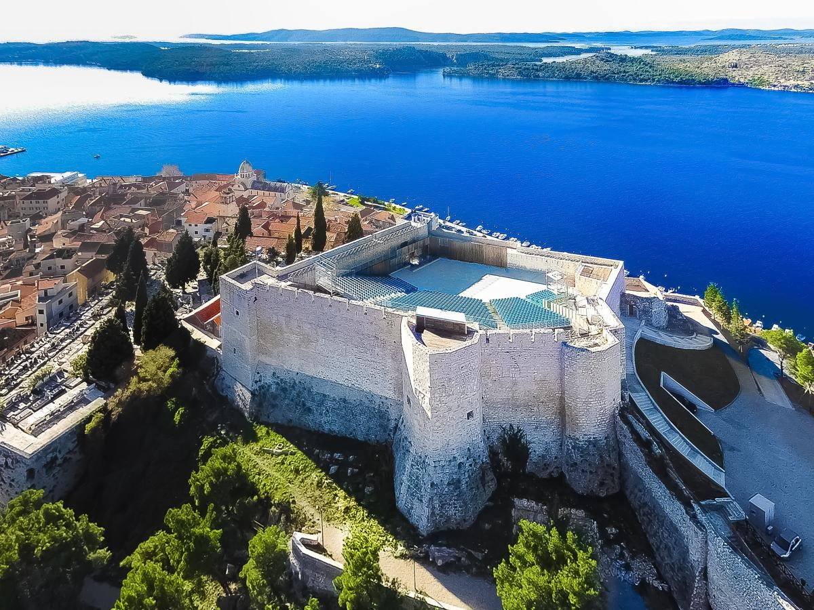
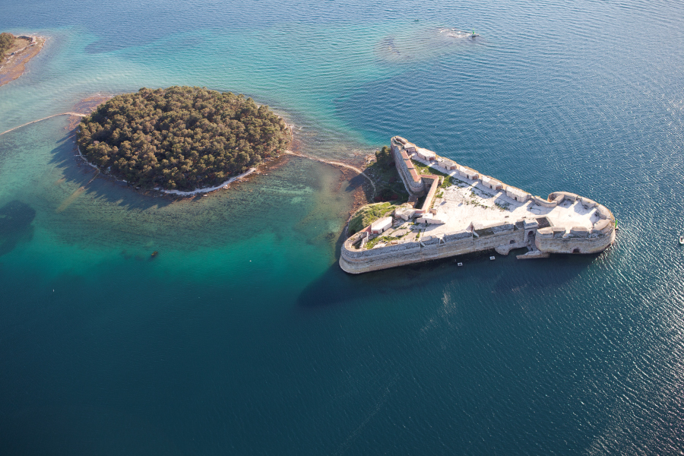
Fortress

Slide 5
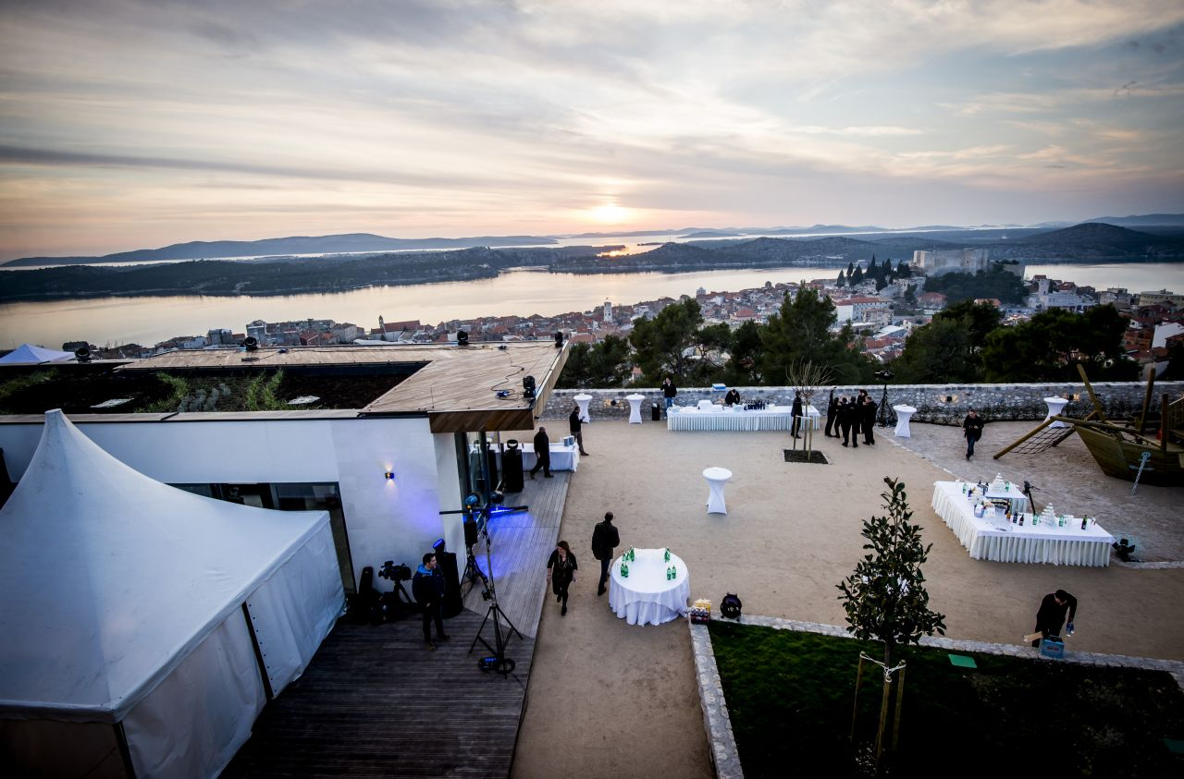
Fortres Barone

Slide 6
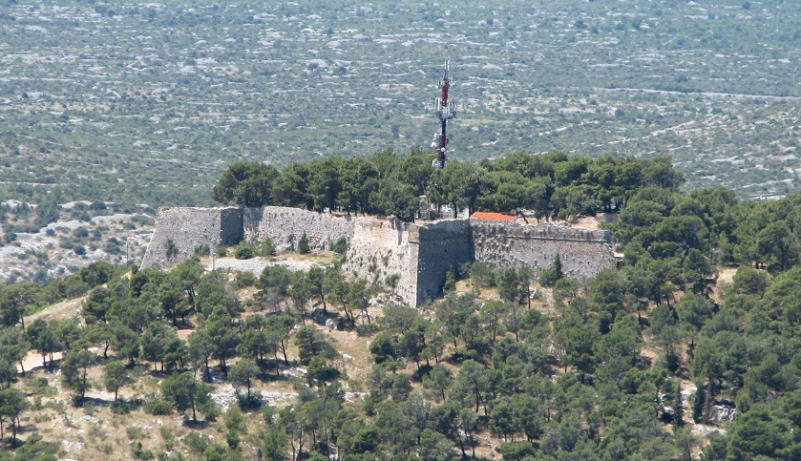
Fortres Sv. Ivan

Slide 7
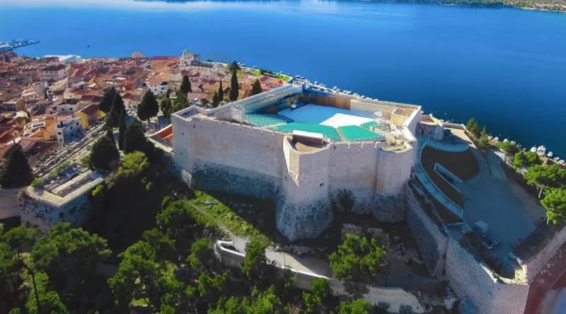
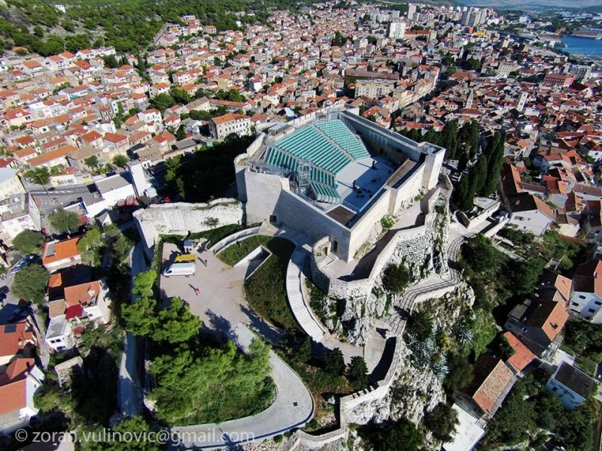
Fortres Sv. Mihovila

Slide 8
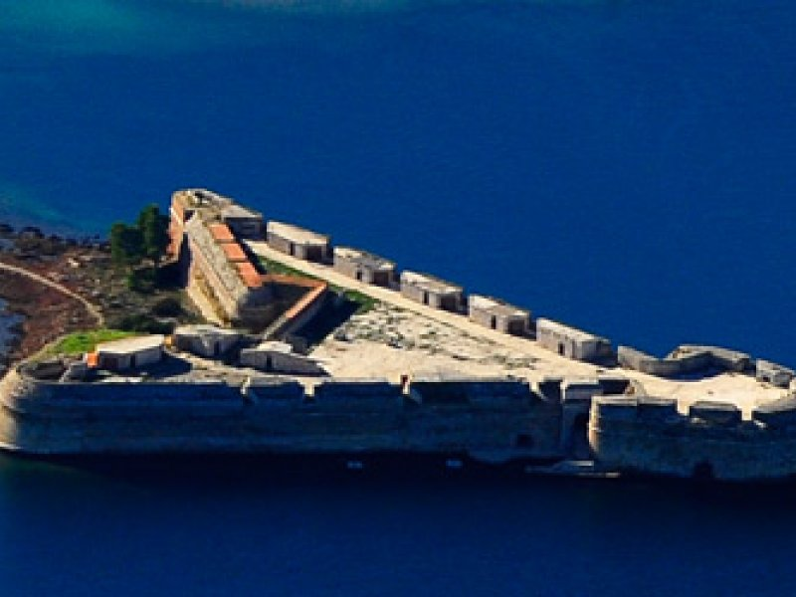
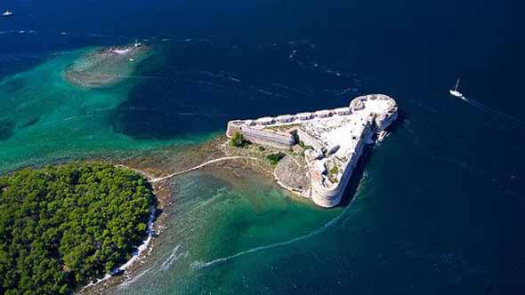
Fortres Sv.Nikole

Slide 9
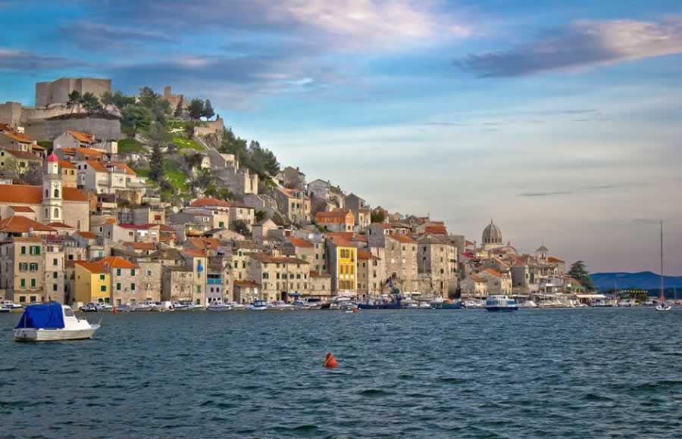
Lucija Glavina , Marta Ćaleta i Marina Žura 8.a

